Slide 1

Economic & Market Outlook 2019
The Other Side of the Growth Hill
Synovus Bank – Chattanooga, TN
January 29, 2019
Gary E. Fullam, CFA
Chief Investment Officer
GLOBALT Investments

Slide 2
What Is Next?
Where are we in the cycle?
  Secular, cyclical, corrections, turns
  Recent world capital market performance
  Valuations
What is affecting the capital markets – global macro issues
  Central bank policy
  Corporate profits & economic growth
  Trade negotiations
  Debt, investment & productivity
  Technicals
  Volatility
Where are we focused?
  The Fed and interest rates
  Earnings reports
  China
  PMI’s
  Technicals
  Volatility
How Our Portfolios are Positioned Today

Slide 3
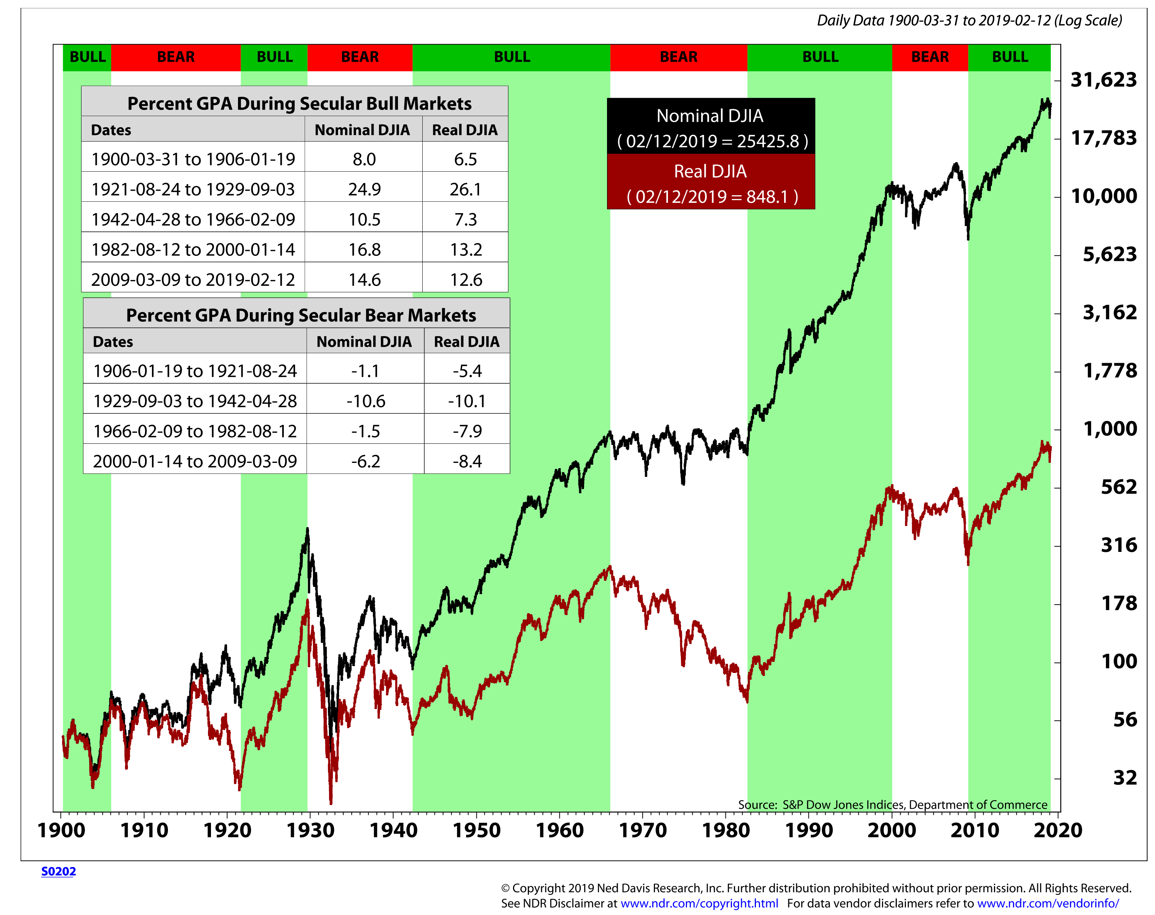
Dow Jones Industrial Average vs. Secular Trends

Slide 4
Asset Class Performance
Year to Date 2019 versus Calendar Years 2018 - 2017
As of January 31, 2019
US Stocks: Russell 3000 Stock Index
Int’l Stocks: MSCI ACWI ex-USA Index
Bonds: Barclays Capital Gov’t /Corp Bond Index
Real Estate: Dow Jones US Real Estate Composite Index
Alternative Inv.: SPDR Gold Shares ETF (as of April 29, 2013)
Cash: 90-Day Treasury Bills
Past Performance is not a guarantee of future investment results. Information shown is Gross-of-Fees – actual Net of Fee performance will be lower than those shown.

Slide 5
International Equity Markets – Price Performance
Year to Date 2019 versus Calendar Years 2018 - 2017
As of January 31, 2019
NOTE: Some countries may be counted in more than one region.
Past Performance is not a guarantee of future investment results. Information shown is Gross-of-Fees – actual Net of Fee performance will be lower than those shown.

Slide 6
Style Returns
Year to Date 2019 versus Calendar Years 2018 - 2017
As of January 31, 2019
Past Performance is not a guarantee of future investment results. Information shown is Gross-of-Fees – actual Net of Fee performance will be lower than those shown.

Slide 7
Bond Sector Returns
Year to Date 2019 versus Calendar Years 2018 - 2017
As of January 31, 2019
Past Performance is not a guarantee of future investment results. Information shown is Gross-of-Fees – actual Net of Fee performance will be lower than those shown.

Slide 8
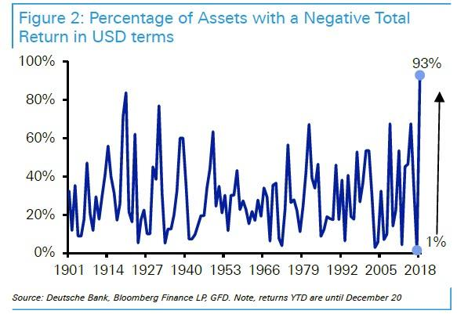
Where Were All of the Winners?

Slide 9
Where Were All of the Winners?
Source: Bloomberg, Morgan Stanley Research; Note: We compute annual returns minus US headline inflation. Green means returns (in USD) beat inflation, and red means returns trailed inflation. 2018 data as of December 17, 2018.

Slide 10
A Side-by-Side Comparison: 2016 Bearishness vs. 2018 Bullishness
Source: Cornerstone Macro – Economics, Policy, Strategy Technicals, January 16, 2018

Slide 11
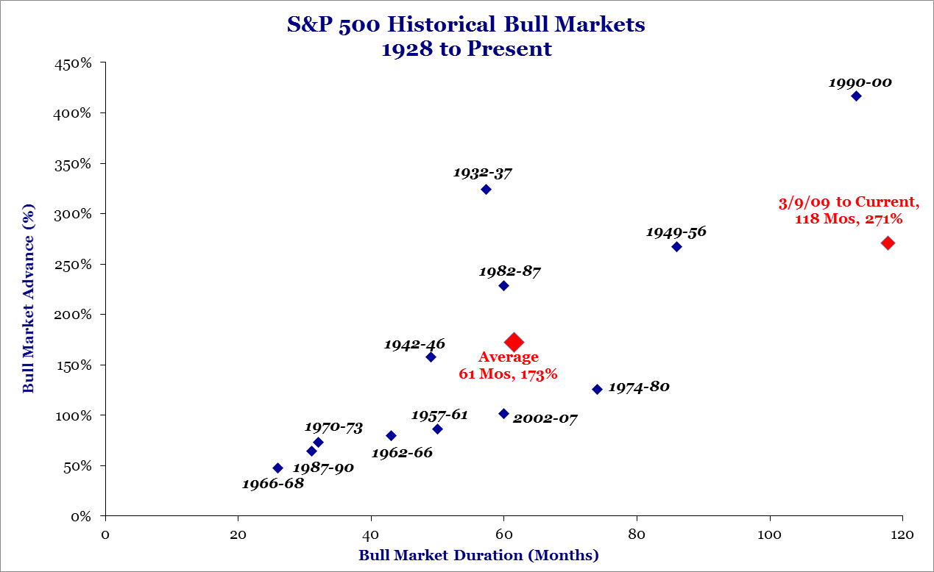
S&P 500 Historical Bull Markets
Source: Strategas, Quarterly Review in Charts - January 2019.

Slide 12
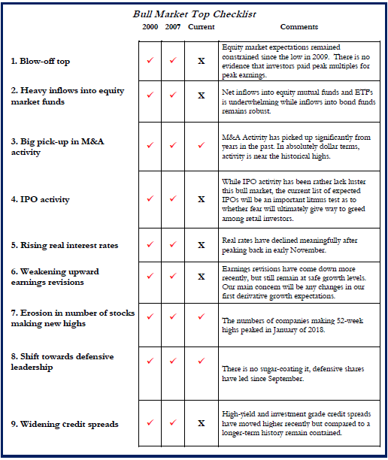
Bull Market Top Checklist
Source: Strategas, Investment Strategy Report, January 2019

Slide 13
Valuation Metrics in Perspective
Source: Strategas, Quarterly Review in Charts – January 2, 2019.

Slide 14
Global Macroeconomic Issues
Where are we in the cycle?
  Secular, cyclical, corrections, turns
  Recent world capital market performance
  Valuations
What is affecting the capital markets – global macro issues
  Central bank policy
  Corporate profits & economic growth
  Trade negotiations
  Debt, investment & productivity
  Technicals
  Volatility
Where are we focused?
  The Fed and interest rates
  Earnings reports
  China
  PMI’s
  Technicals
  Volatility
How Our Portfolios are Positioned Today

Slide 15
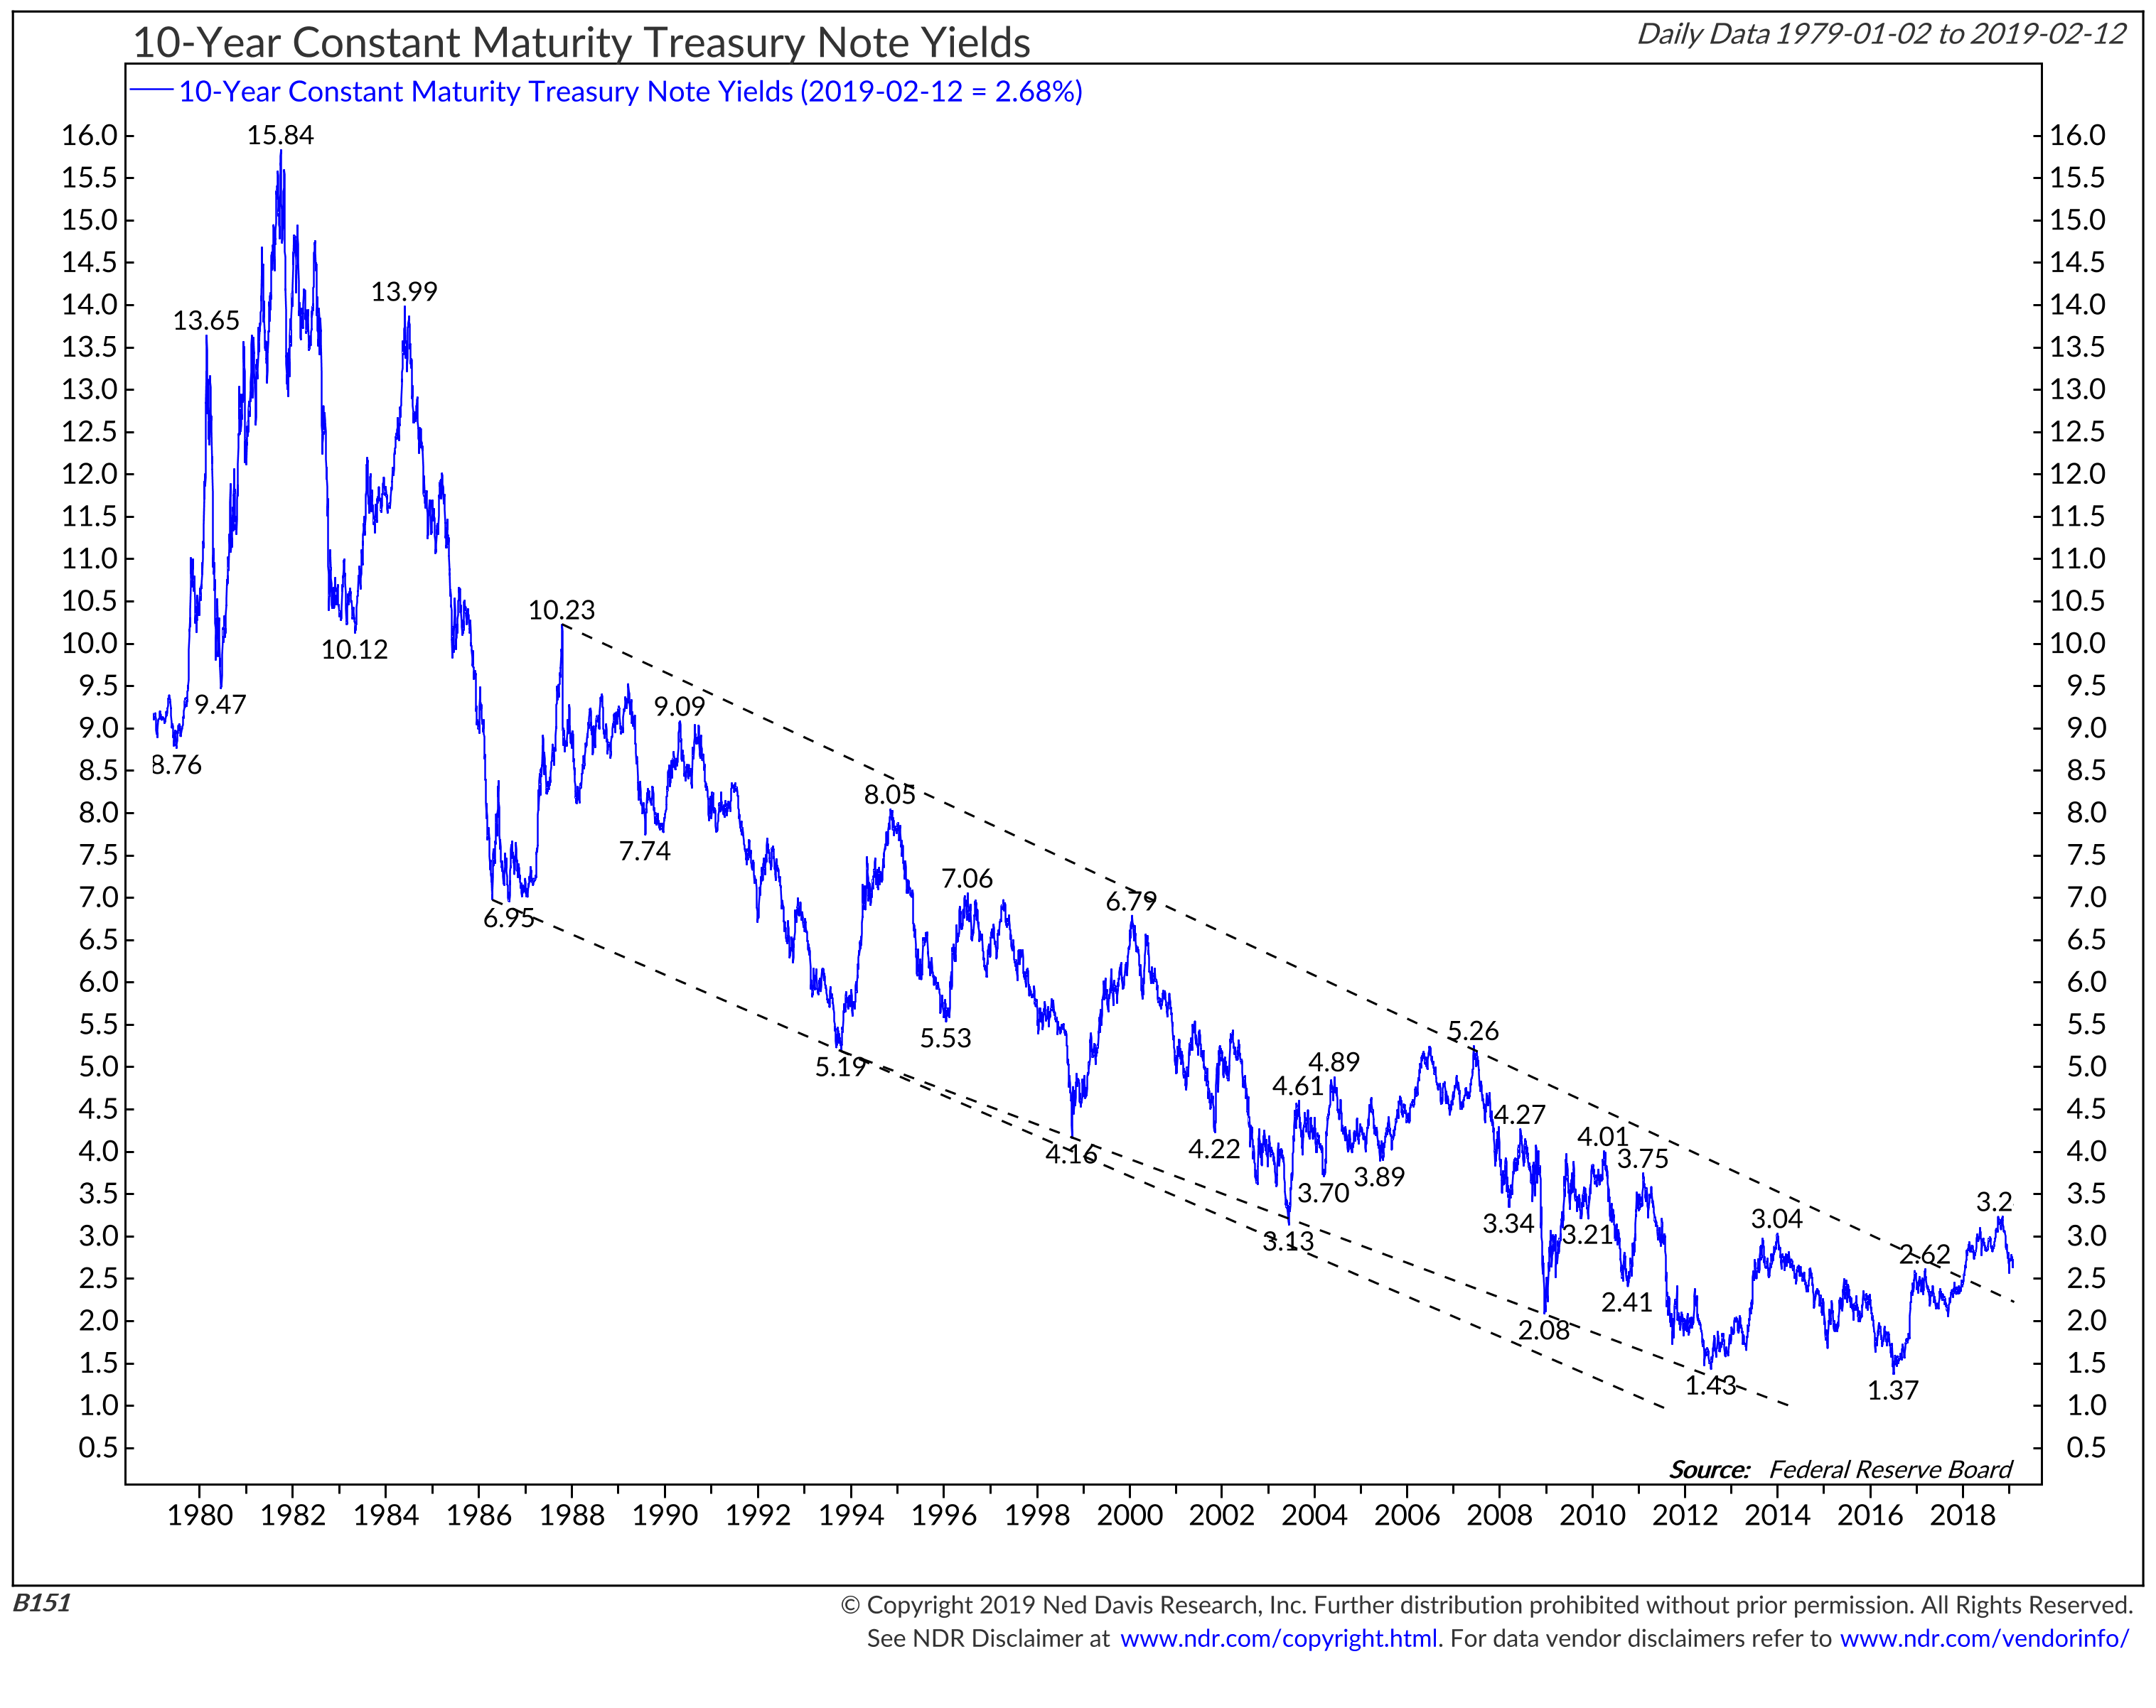
Ten Year Treasury Yields

Slide 16
Central Bank Summary
Fed – 9 Hikes since start of this cycle
– Now at 2.25 – 2.50%
– Dot Plot shows 3 more left
ECB – On Hold
BoE – On Hold
BoJ – On Hold

Slide 17
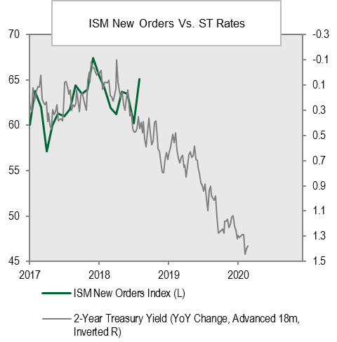
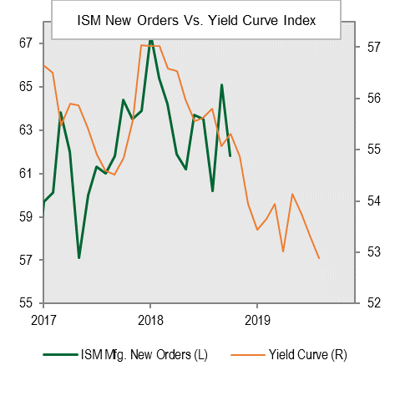
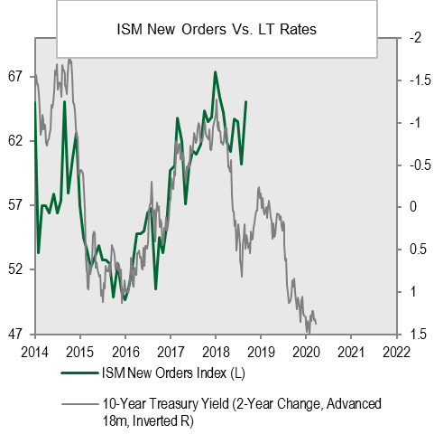
Important Questions for the Road Ahead
Policy: Are Low Rates Muting the Efficacy of Monetary Tightening?
Tightening in the Pipeline Catching up to US Leading Indicators
Source: Cornerstone Macro – October 1, 2018.

Slide 18
Corporate Profits
S&P 500 EPS Y ear/Year Growth Quarterly
 | 1Q | 2Q | 3Q | 4Q | Full Year
2016 | -6.7% | -3.5% | 3.1% | 5.4% | 0.5%
2017 | 13.9 | 16.3 | 6.4 | 15.0 | 11.0
2018 | 24.8 | 25.0 | 26.0 | 12.4e | 20.3e
2019e | 3.5 | 4.1 | 4.6 | 11.8 | 7.9
GDP Quarterly Growth SAAR
 | 1Q | 2Q | 3Q | 4Q | Full Year
2016 | 0.8% | 1.4% | 3.5% | 2.1% | 1.5%
2017 | 1.2 | 3.1 | 3.3 | 2.9 | 2.3
2018 | 2.0 | 4.2 | 3.4 | 2.7e
2019 |  |  |  |  | 2.3e
2020 |  |  |  |  | 1.8e
Source: FactSet 2018.

Slide 19
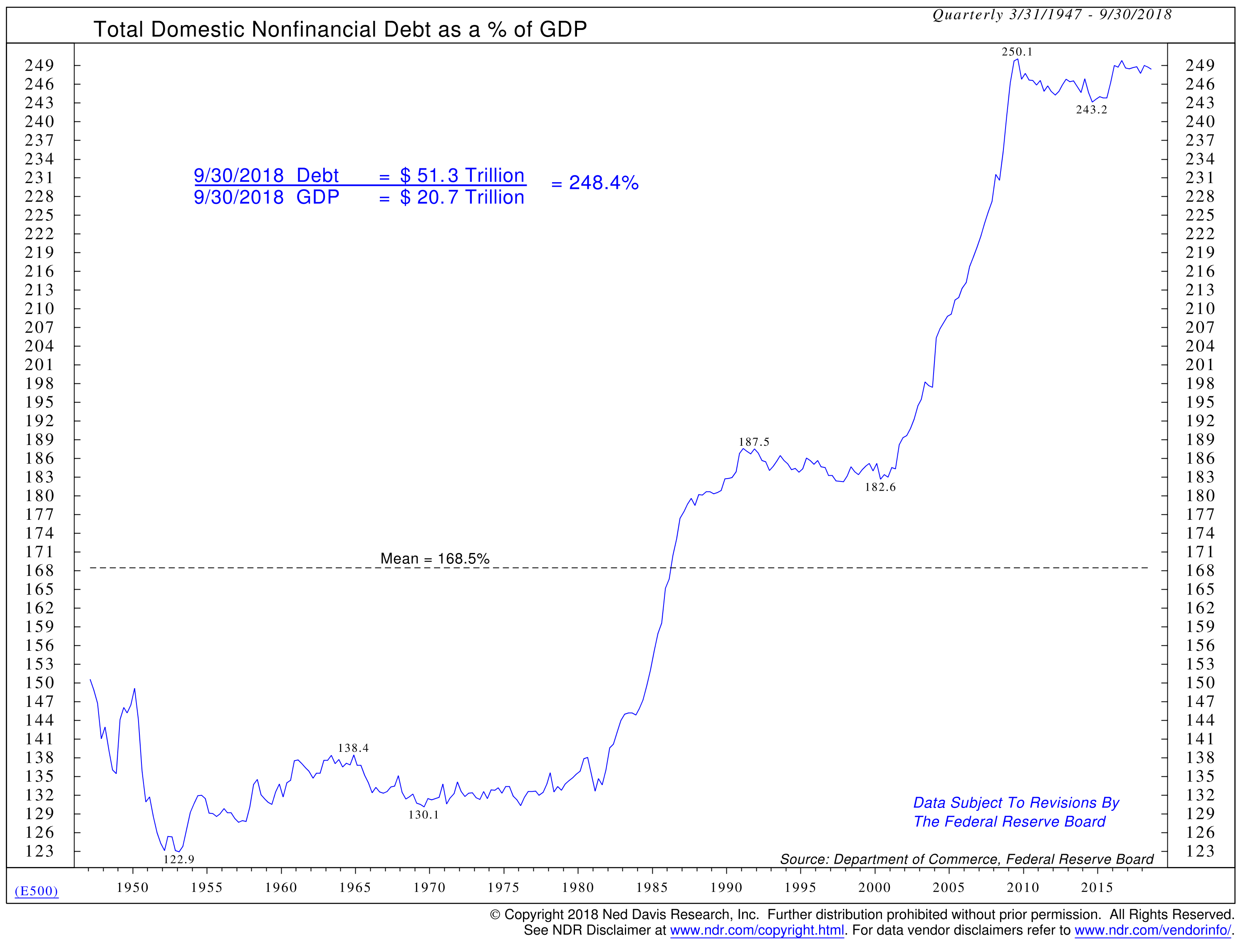
Debt is Very High

Slide 20
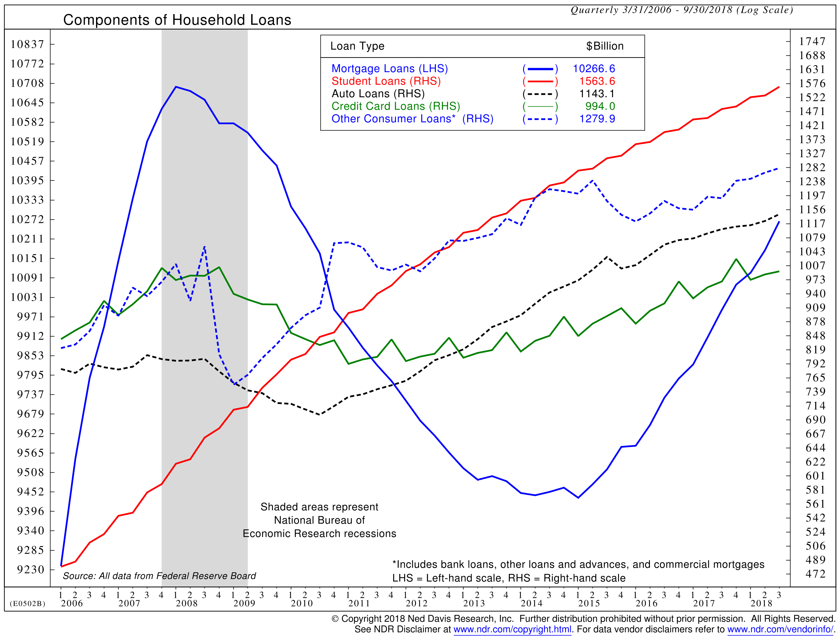
The Components Have Changed

Slide 21
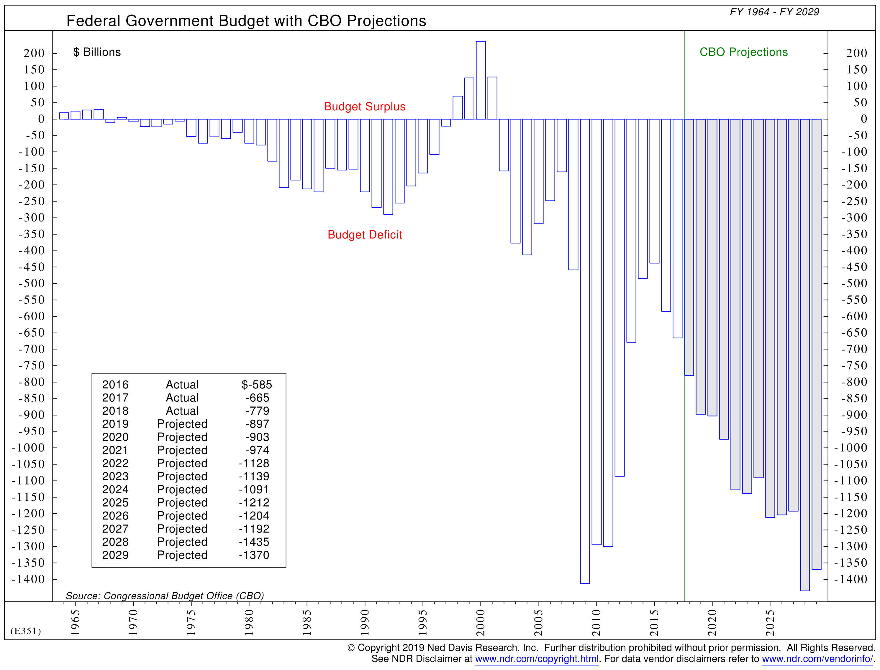
Deficits are Still Growing

Slide 22
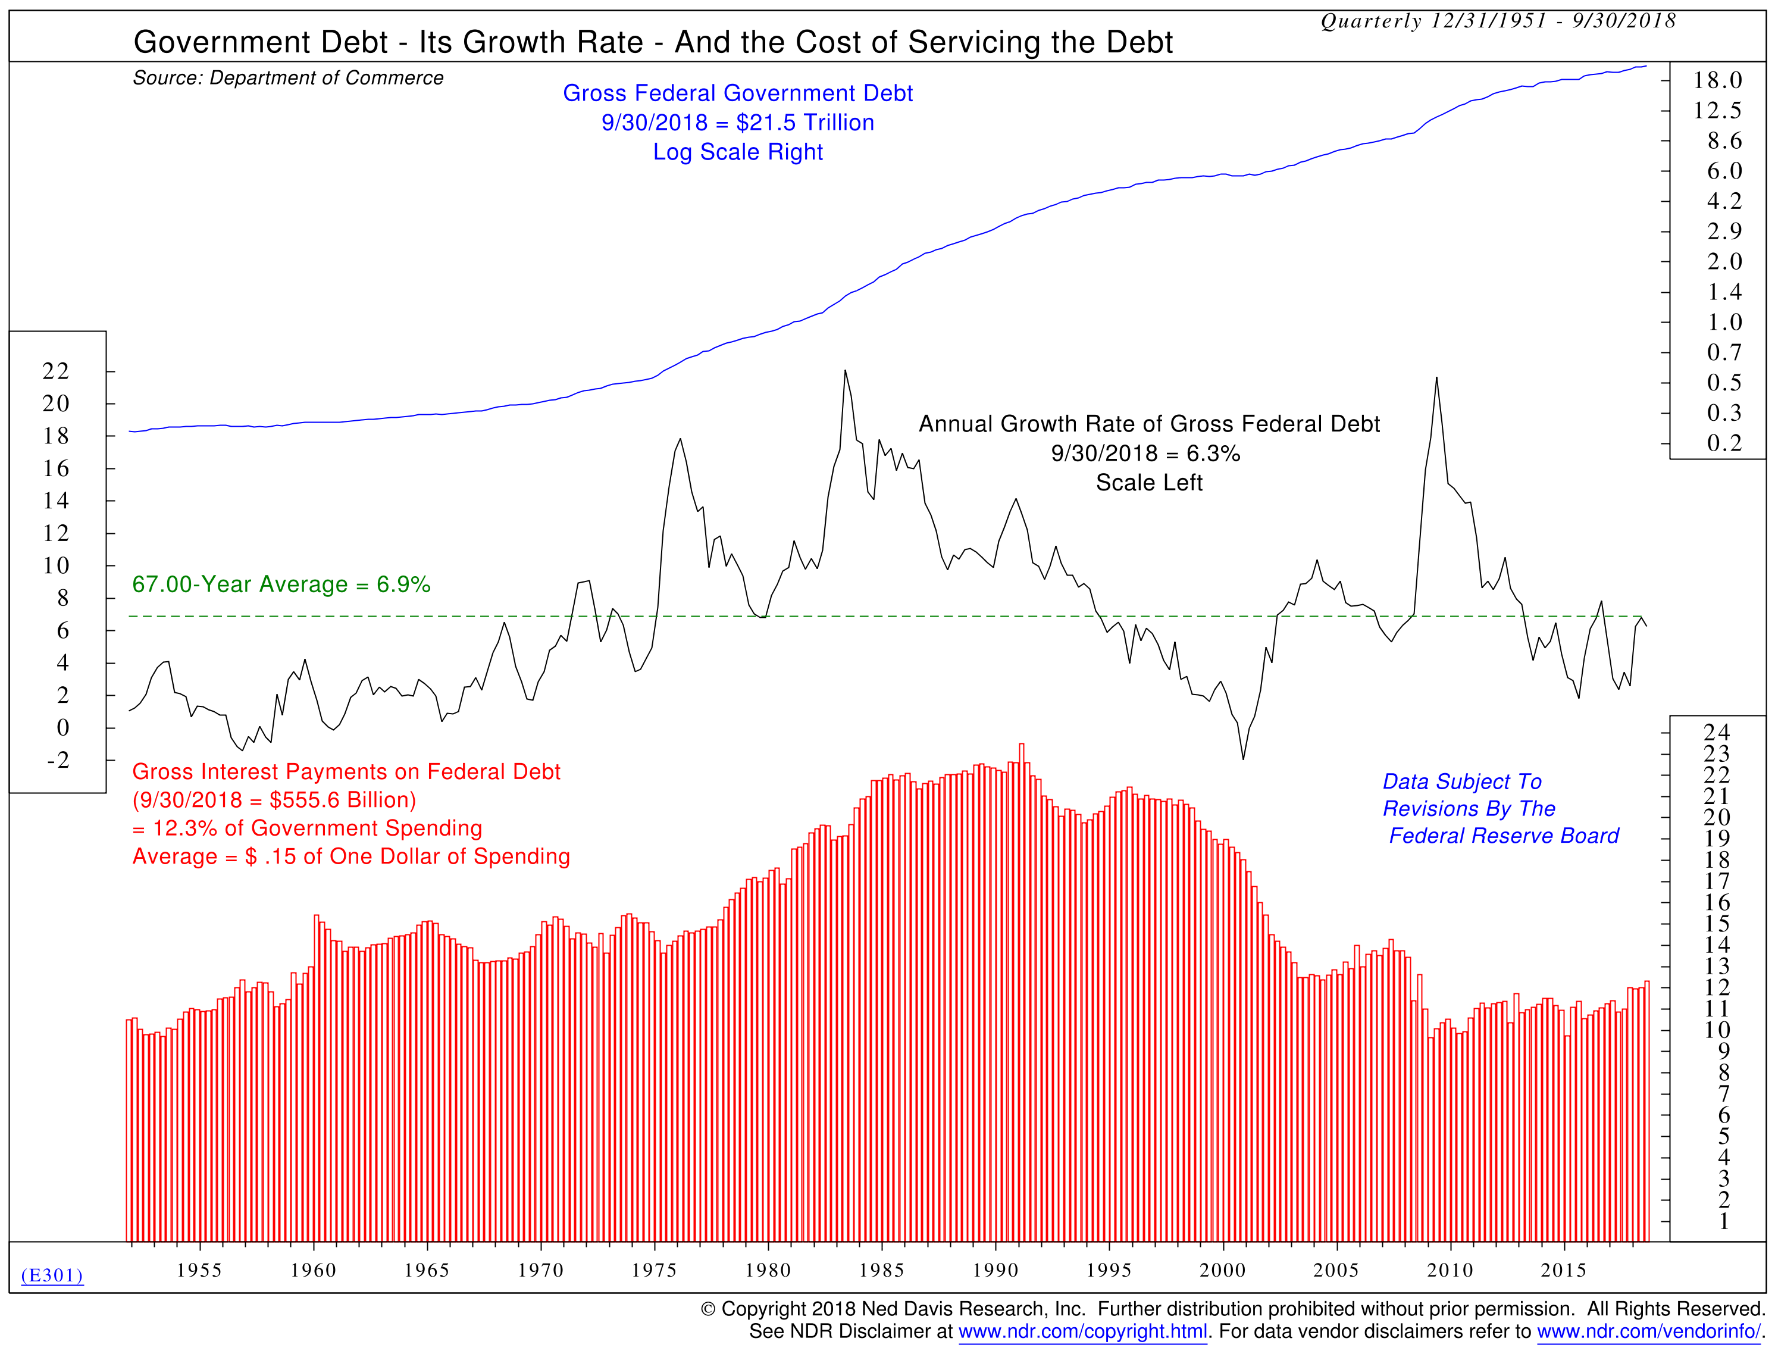
Interest Payments are Rising

Slide 23
GDP Growth
Source: J.P. Morgan Asset Management; (Top left) Census Bureau, DOD, DOJ; (Top left and right) BLS; (Right and bottom left) BEA.
GDP drivers are calculated as the average annualized growth in the 10 years ending in 4Q of the last year. Future working-age population is calculated as the total estimated number of Americans from the Census Bureau, per the September 2018 report, controlled for military enrollment, growth in institutionalized population and demographic trends. Growth in working-age population does not include illegal immigration; DOD Troop Readiness reports used to estimate percent of population enlisted.
Guide to the Markets – U.S. Data are as of December 31, 2018.
See Compliance Note at presentation end.

Slide 24
Labor Market Perspectives
Source: BLS, FactSet, J.P. Morgan Asset Management. (Bottom right) Info. Fin. & bus. Svcs. = Information, financial activities and professional and business services; Mfg. trade & trans. = Manufacturing, trade, transportation and utilities; Leisure, hospt. & other svcs. = Leisure, hospitality and other services; Educ. & health svcs. = Education & health services; Mining & construct. = Natural resources mining and construction; Gov’t = Government. *Aging effect on the labor force participation rate is the estimated number of people who are no longer employed or looking for work because they are retired. Cyclical effect is the estimated number of people who lose their jobs and stop looking for work or do not look for work because of the economic conditions. Other represents the drop in labor force participation from the prior expansion peak that cannot be explained by age or cyclical effects. Estimates for reason of decline in labor force participation rate are made by J.P. Morgan Asset Management.
Guide to the Markets – U.S. Data are as of December 31, 2018.
See Compliance Note at presentation end.

Slide 25
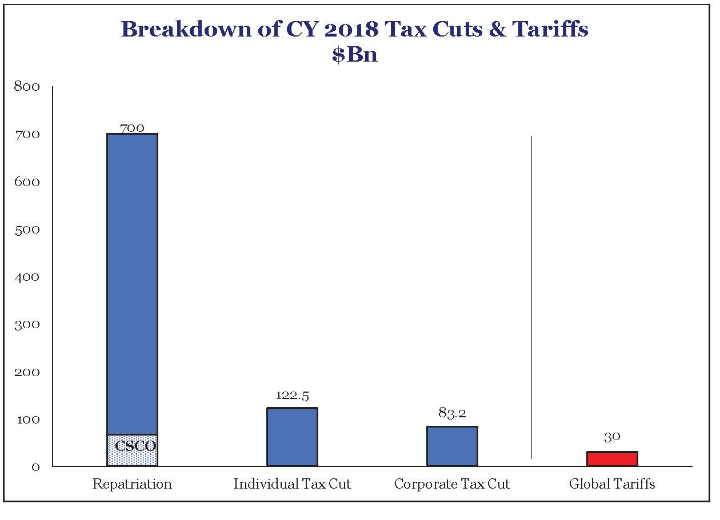
Fiscal Policy is Dwarfing Tariffs in 2018
Source: Strategas, Quarterly Review in Charts – October 2018.

Slide 26
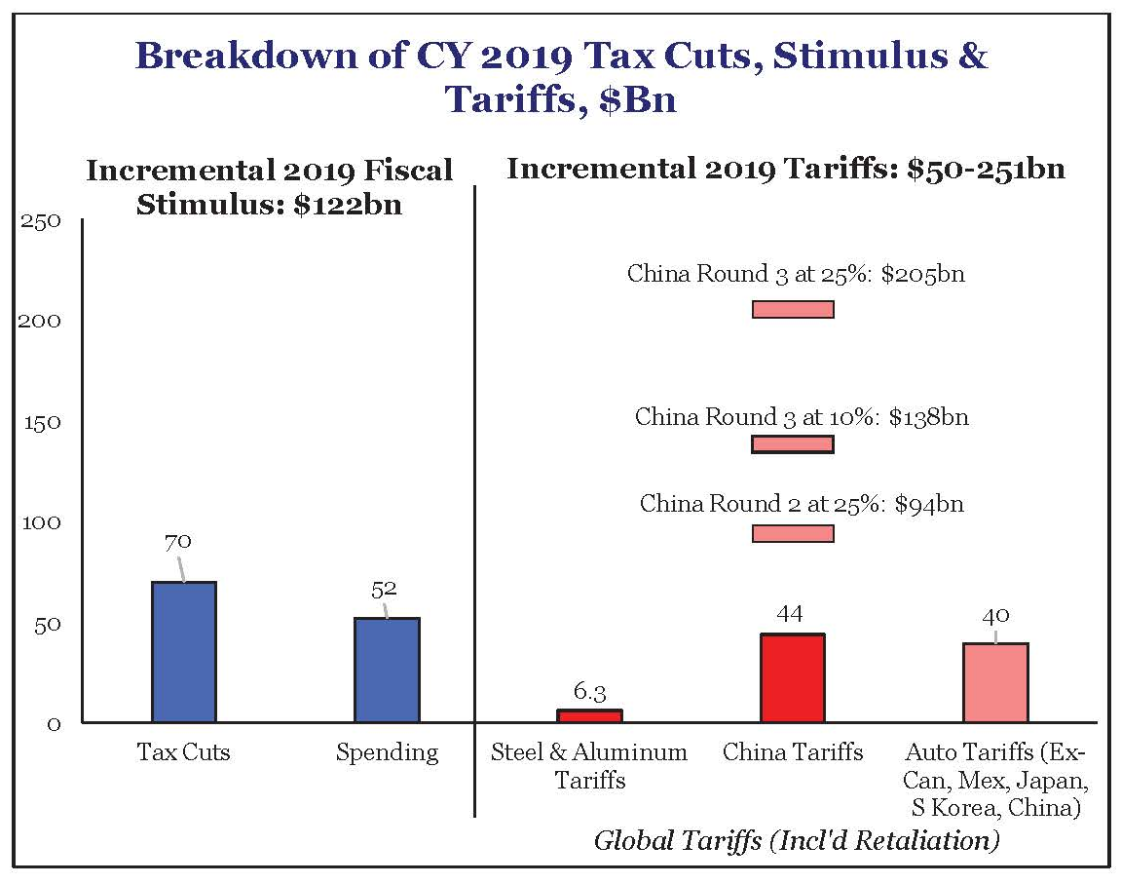
But 2019 Paints a Different Picture
Source: Strategas, Policy Outlook – December 4, 2018.

Slide 27
Market Corrections
Average Correction in Midterm Election Year ≈19%
Source: 2018 Strategas Research Partners.

Slide 28
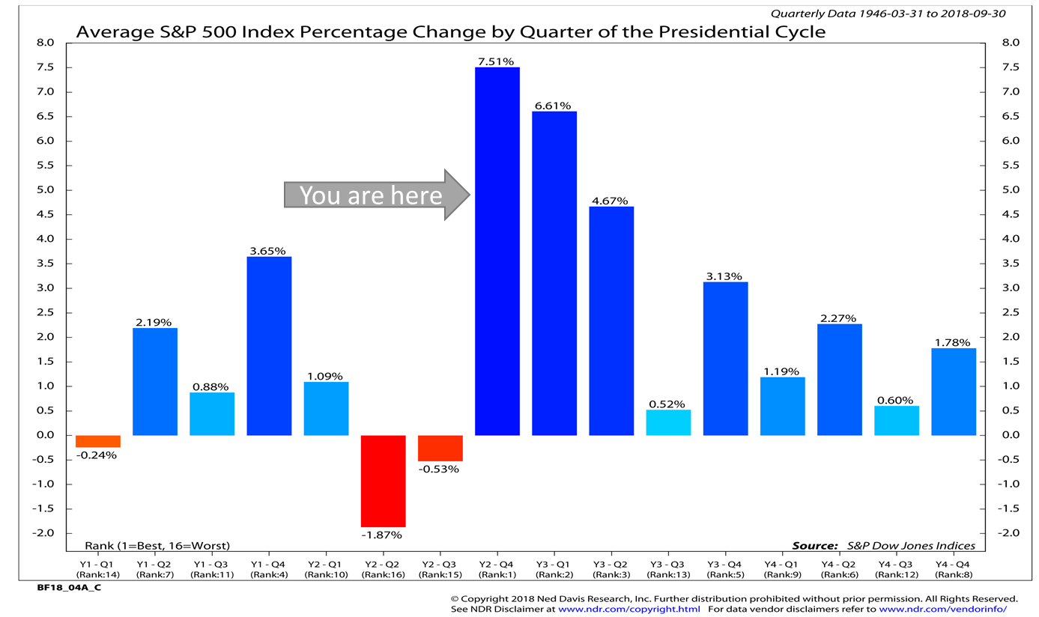
Now or Never?

Slide 29
Key S&P 500 Levels for 2019: 2,375 – 2,700
Source: Oppenheimer & Co. and Bloomberg. Note: These results cannot and should not be viewed as an indicator of future performance. January 1, 2019.

Slide 30
Playing by Secular Bull Market Rules
Secular bull
Source: Oppenheimer & Co. and Bloomberg. Note: These results cannot and should not be viewed as an indicator of future performance. January 1, 2019.

Slide 31
Cyclical Bears in Secular Bulls: 8, -20%, 50%
The average magnitude has been reached, but not the average duration
Source: Oppenheimer & Co. and Bloomberg. Note: These results cannot and should not be viewed as an indicator of future performance. Shaded gray = secular bear. Colored red = US recession. January 1, 2019.

Slide 32
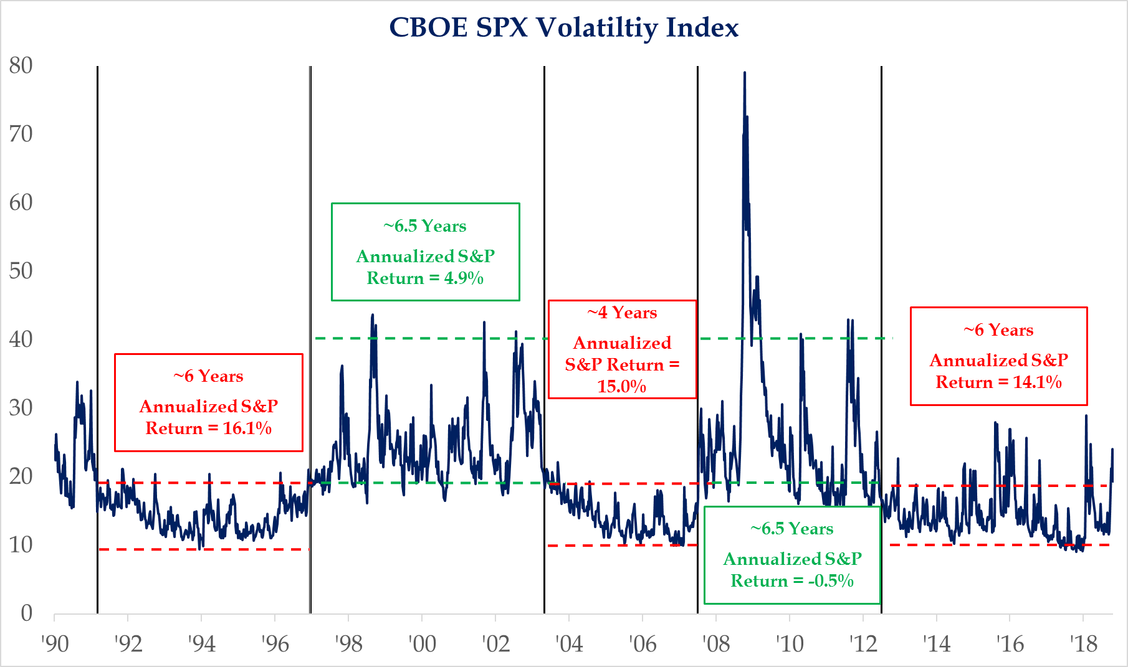
Volatility Typically Moves in a Secular Fashion
Source: Strategas, October 31, 2018.

Slide 33
Global Macroeconomic Issues
Where are we in the cycle?
  Secular, cyclical, corrections, turns
  Recent world capital market performance
  Valuations
What is affecting the capital markets – global macro issues
  Central bank policy
  Corporate profits & economic growth
  Trade negotiations
  Debt, investment & productivity
  Technicals
  Volatility
Where are we focused?
  The Fed and interest rates
  Earnings reports
  China
  PMI’s
  Technicals
  Volatility
How Our Portfolios are Positioned Today

Slide 34
How the Portfolio is Positioned Today
Underweight total combination of equities and real estate.
Equal weight US equities.
  Overweight: large growth and mid growth
  Underweight: large value, small growth and small value
Underweight overall to international equities.
Underweight bonds. Bond weighting overall has a slightly longer duration than the benchmark bond index.
Market weight REITs.
No positions in Alternatives.
Overweight Cash.

Slide 35
Compliance Note
GLOBALT Investments is an SEC-registered investment adviser since 1991 and, effective July 2013, remains a registered investment adviser through a separately identifiable division of Synovus Trust Company N.A., a nationally chartered trust company. Synovus Trust Company is indirectly owned by Synovus Financial Corp. Effective July 10, 2013, GLOBALT and all of its personnel consolidated with Synovus Trust Company (its affiliate since 2002) as a separately identifiable division. This division continues to operate under the “GLOBALT” name. GLOBALT provides professional money management to both institutional and individual investors through equity, fixed income, and ETF asset allocation strategies.
Information contained herein was obtained from sources believed to be reliable, however, we cannot guarantee its accuracy or completeness. Opinions, estimates, forecasts, and statements of financial market trends that are based on current market conditions constitute our judgment and are subject to change without notice. Any security, allocation, or weightings described herein are subject to change without notice and no assurances are made that they will remain in a strategy or portfolio at the time you receive this information. Sample or model strategies or portfolios shown may not be representative of strategies or portfolios of existing clients. Any performance numbers shown are preliminary and subject to change without notice.
Past performance is not a guarantee of future investment results. There are risks, including possible loss of principal, associated with investing in securities, including but not limited to erratic or volatile market conditions, financial and debt market risk, geopolitical risk, management risk, liquidity, non-diversification risk, credit and counterparty risk. Diversification and/or strategic asset allocation do not guarantee a profit nor protect against a loss in declining markets. Investors should carefully consider investment objectives, risks, charges and expenses. This and other important information is contained in GLOBALT’s Form ADV Part 2 which is provided by your investment adviser and should be read carefully prior to investing. Trademark(s) belong to their respective companies and are the property of their respective owners. The information herein is not a substitute for professional tax advice. You should consult your tax advisor for specific questions regarding your own tax situation. Indexes are unmanaged and it is not possible to invest directly in an index. Index returns shown do not represent the results of actual trading of investor assets.
Index returns do not reflect payments of any sales charges, fees, or expenses that an investor would pay or incur to purchase or own the securities that indices represent. The imposition of such fees, charges or expenses would cause actual and back-tested performance to be lower than the performance shown for that index. Exposure to an asset class represented by an index may be available through investable instruments based on that index. There is no assurance such investment products will accurately track index performance or provide positive investment returns.
This material has been prepared for informational purposes only and should not be construed as investment advice or a recommendation or solicitation to purchase or sell any security. Content may not be reproduced, distributed, or transmitted in whole or in part by any means without written permission from GLOBALT. Regarding permission as well as to receive a copy of GLOBALT’s Form ADV Part 2, contact GLOBALT Compliance, 3400 Overton Park Drive, Suite 500, Atlanta GA 30339.
Investment products and services provided by Synovus are offered through Synovus Securities, Inc ("SSI"), Synovus Trust Company, N.A. ("STC"), GLOBALT, a separately identifiable division of STC and Creative Financial Group, a division of SSI. Trust services for Synovus are provided by Synovus Trust Company, N.A. The registered broker-dealer offering brokerage products for Synovus is Synovus Securities, Inc., member FINRA/SIPC. Investment products and services are not FDIC insured, are not deposits of or other obligations of Synovus Bank, are not guaranteed by Synovus Bank and involve investment risk, including possible loss of principal amount invested. Synovus Securities, Inc. is a subsidiary of Synovus Financial Corp and an affiliate of Synovus Bank and Synovus Trust. Synovus Trust Company, N.A. is a subsidiary of Synovus Bank. You can obtain more information about Synovus Securities, Inc. and its Registered Representatives by accessing BrokerCheck.
Approval of any bank product or service is not contingent upon purchasing insurance from Synovus Bank. Insurance products marketed through Synovus and its affiliated companies are underwritten by insurance companies not affiliated with Synovus and are subject to normal underwriting procedures.

