Slide 1

Economic Forecast 2019
Featured Speaker: Daniel Morgan,
Senior Portfolio Manager

Slide 2
About Synovus Trust
Synovus Trust Company, N.A. provides trust, estate and investment services through 11 offices and approximately 120 employees
in Alabama, Georgia, Florida and South Carolina
As of April of 2018, total Assets Under Management stood at over $14.1 billion
Synovus Family Asset Management named one of Top 50 Family Offices (Bloomberg Markets Magazine)
Our company expanded from Columbus Bank & Trust Company, a division of Synovus Bank, in 1995 and acquired a national
charter in 2002
Our history of service and expertise dates back to the inception of Synovus in 1888
  About Synovus: Synovus (NYSE: SNV) is a financial services company with $31 billion in assets based in Columbus, Georgia. Synovus’ bank divisions provide commercial and retail banking, investment and mortgage services to customers in Georgia, Alabama, South Carolina, Florida and Tennessee.
  About Synovus Bank: Synovus Bank is a Georgia-chartered, FDIC-insured bank. Synovus Bank, together with its affiliates, provides commercial and retail banking, investment, and mortgage services to customers through 28 locally branded bank divisions and 250 branch locations in Georgia, Alabama, South Carolina, Florida, and Tennessee.

Slide 3
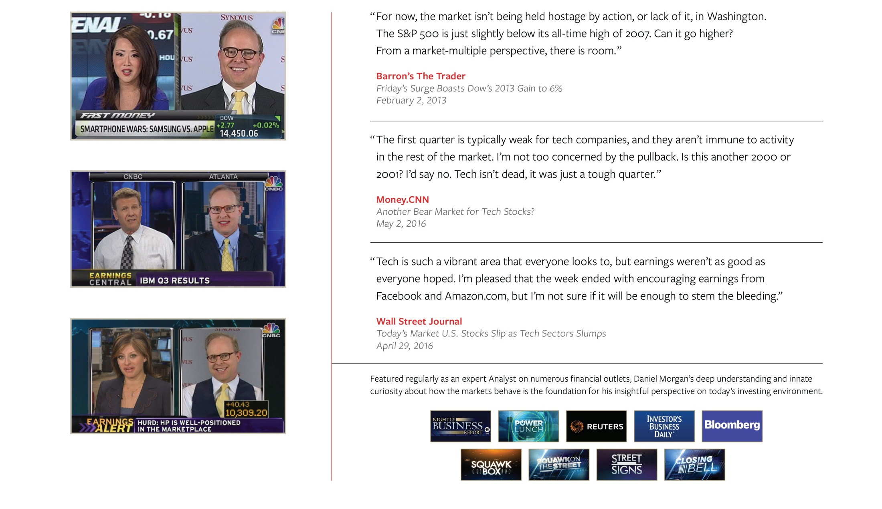
Daniel Morgan
Portfolio Manager, Synovus Trust Company, N.A.

Slide 4


“More Entertaining than Sitting Next to Ted Striker”
Air Force Pilot Ted Striker discusses his break-up with ex-girlfriend Elaine to Nearly Bored to Death Seat Mate.

Slide 5

“To be ignorant of what occurred before you were born is to remain always a child. For what is the worth of human life, unless it is woven into the life of our ancestors by the records of history?”
— Cicero , 55 B.C.

Slide 6
Can this Economic Expansion Continue this Late in the Cycle?

Slide 7
Today’s Economy and Financial Markets
Economic Indicator
4Q18 Real GDP
2.60%
4Q18 Personal Consumption
2.80%
4Q18 Core PCE QoQ
1.50%
4Q18 Business Investment
6.20%
Oil per Barrel
$48
Unemployment Rate
4.00%
Underemployment Rate
8.10%
Non-farm Payrolls
304K
Average Hourly Wages YoY
3.20%
U.S. GDP
  Current expansion is now the second longest in history at 10 years, but has produced below average growth of 2.3% vs an average of 4.1% for the past 12 US economic expansions.
  Tax cuts and higher fixed investment spending levels combined with a strong labor market have resulted in improved US GDP growth for FY2018 of 2.9%.
Federal Reserve Policy
  The Fed has raised the Fed Funds rate 9x since 2015 placing the FFUND’s rate at 2.25%-2.50%.
  The Fed has Forged Ahead Tightening BEFORE a pronounced increase in Prices (PCE) or Hourly Wages.
Stock Market
  This Ten Year Bull Market is “Long-in-the-Tooth”
  For FY18 S&P 500 Companies have reported Corporate Profit growth of 24%.

Slide 8
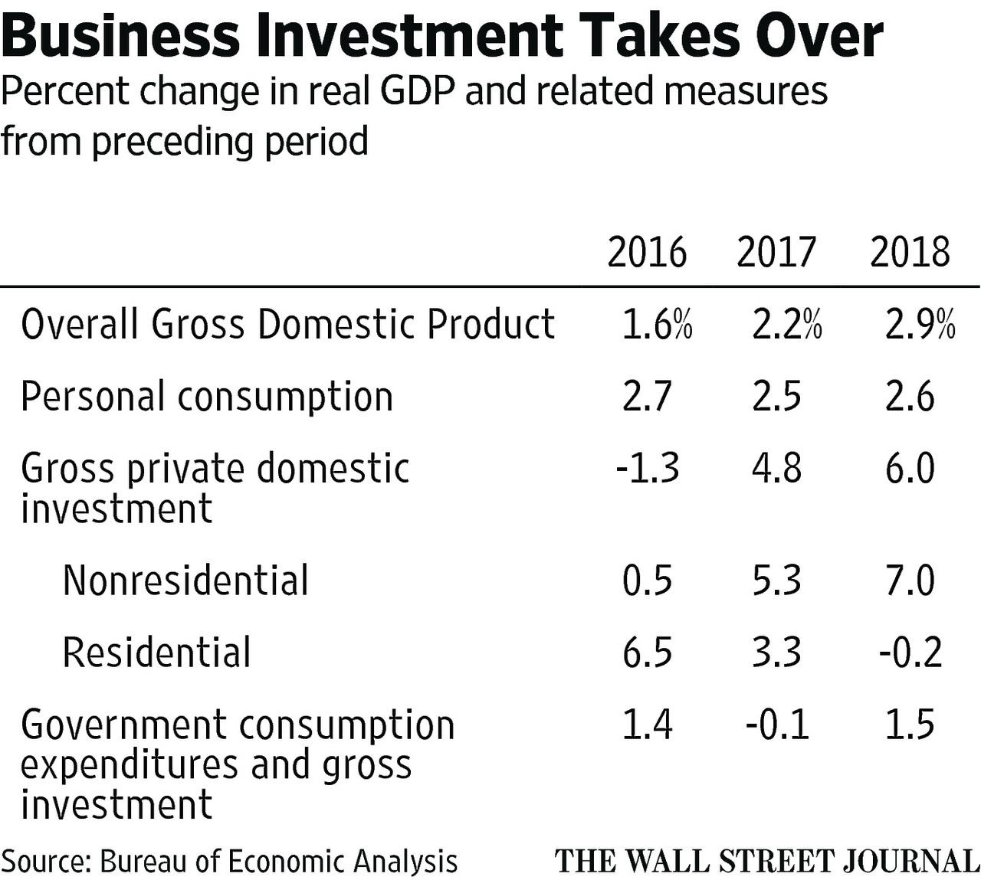

Slide 9
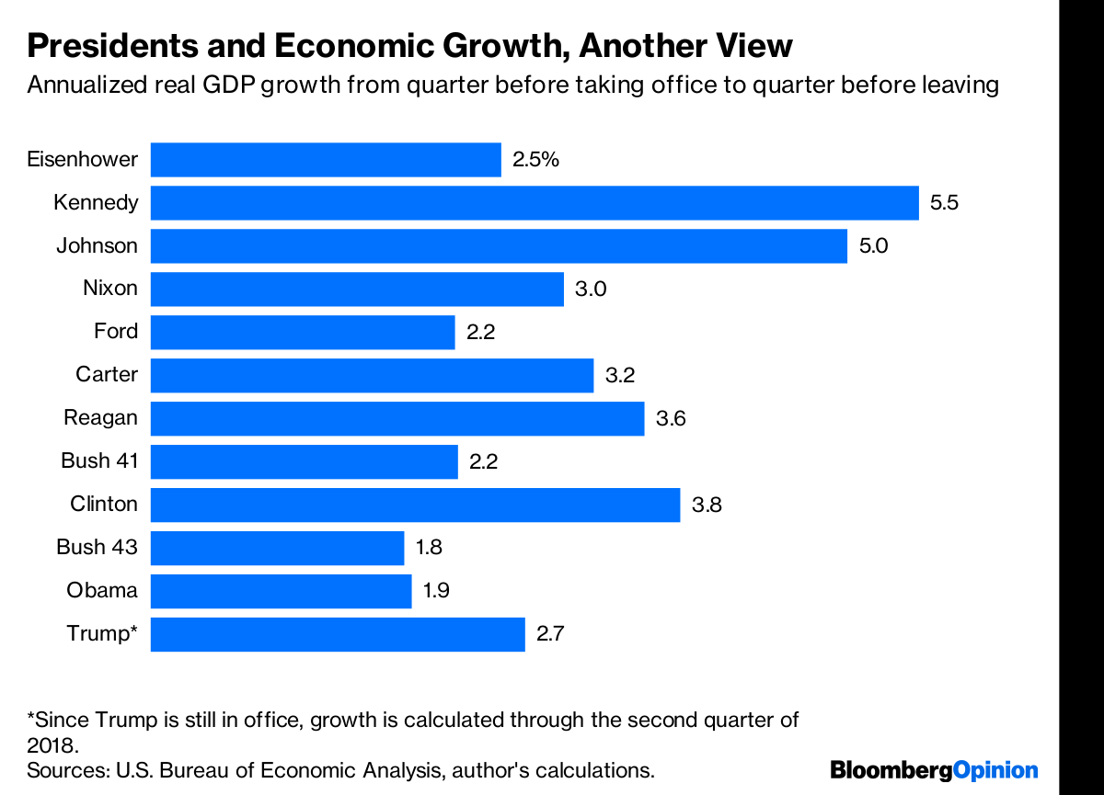

Slide 10
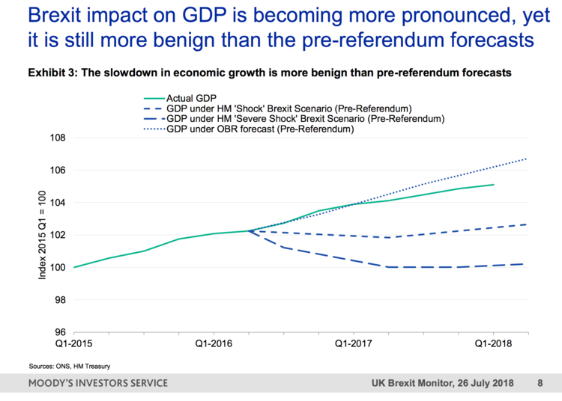

Slide 11
Is the Fed’s Move to Normalize Interest Rates Warranted and will Higher Rates Cause the Economy to Contract?

Slide 12
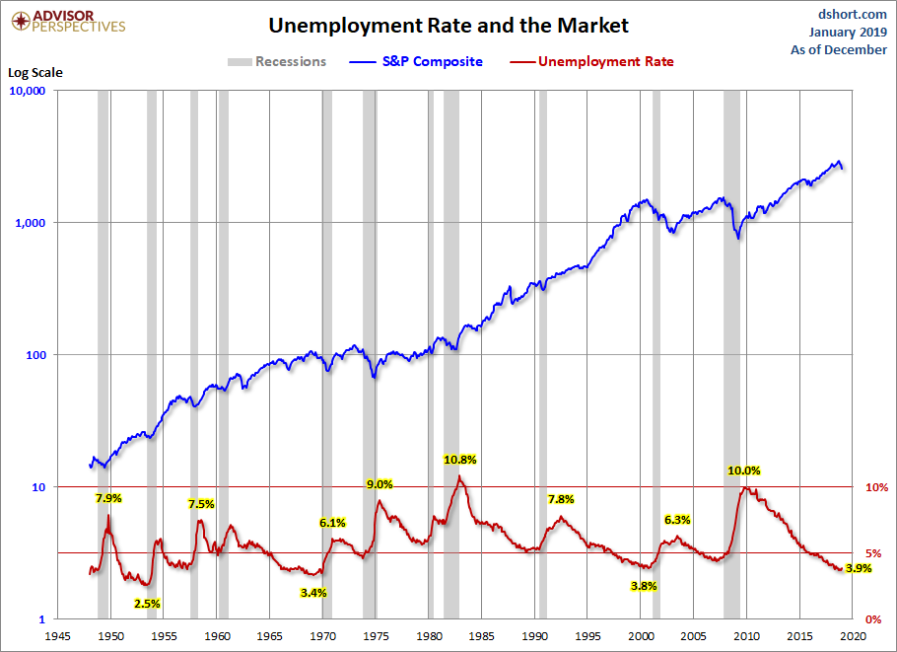
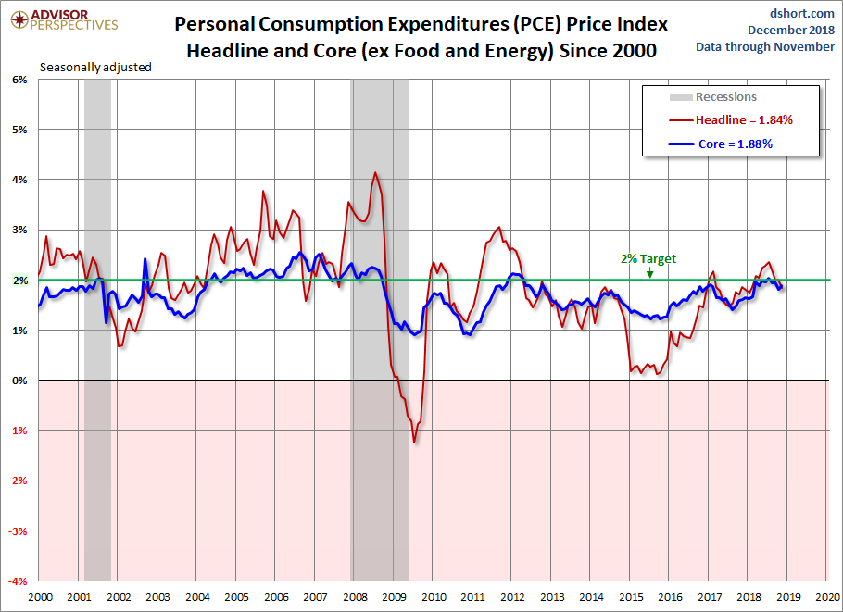
Federal Reserve’s Dual Mandate
Source: Bureau of Labor Statistics, Bureau of Economic Analysis, Bloomberg.

Slide 13
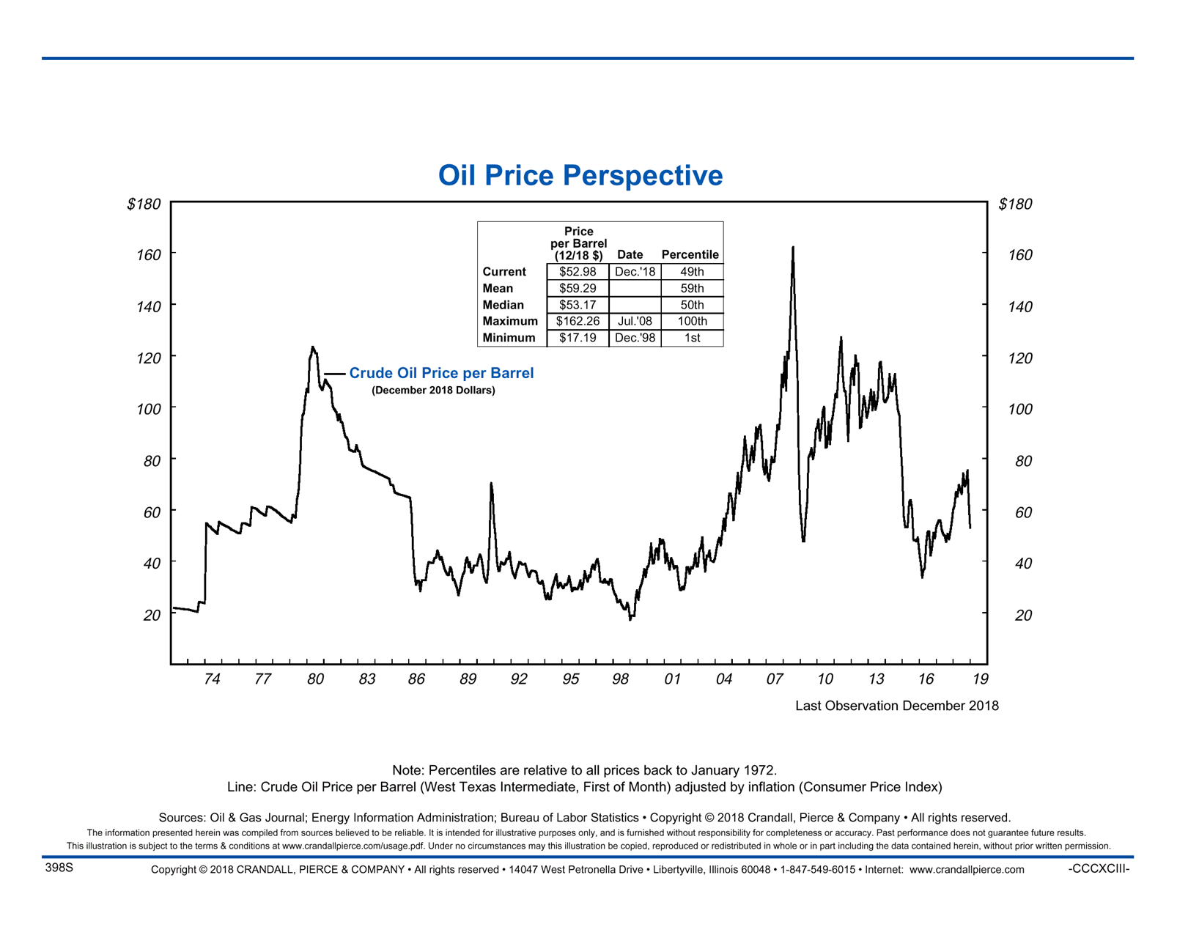

Slide 14
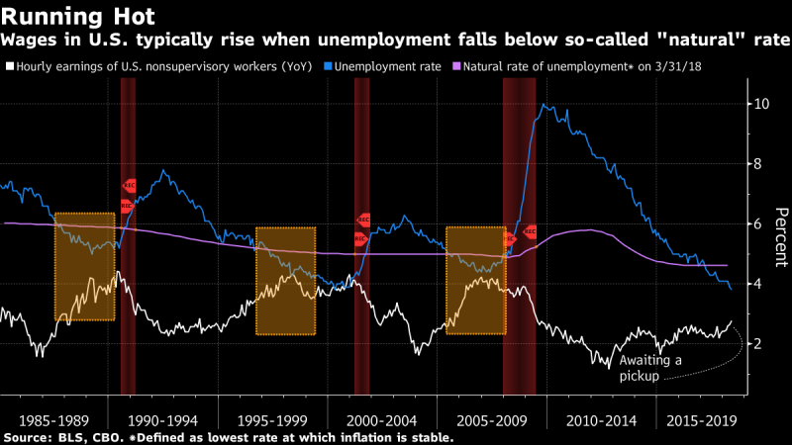

Slide 15
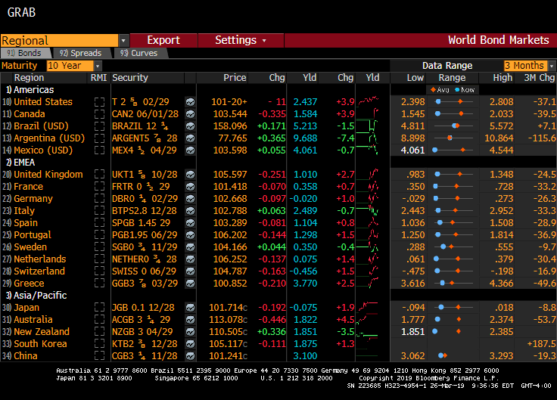
International Bond Yields Keep US Treasury Bond Yield’s Low

Slide 16
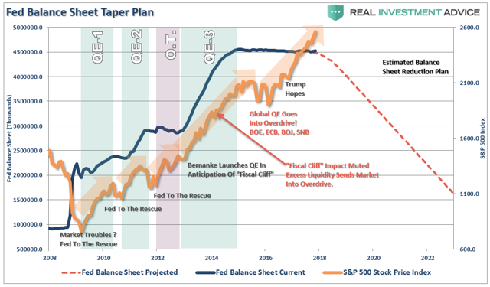
Fed has Reduced Balance Sheet to $4.1 Trillion

Slide 17
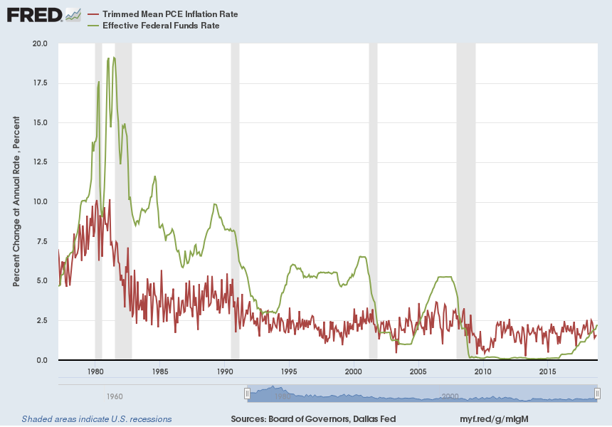
Historically the FFUND Rate is set 80 B.P. above the PCE Index

Slide 18
Is the Current Stock Market Volatility just a Correction or are we Heading into Bear Market Territory?

Slide 19
The Most Joyless Bull Market Ever
Causes of Investor’s Anxiety
Inverted Yield Curve
Brexit
Trade “Wars”
“Peak” Earnings
Inflation
Democrat Controlled House
Fed Tightening/Balance Sheet Run-off
Federal Debt Levels

Slide 20
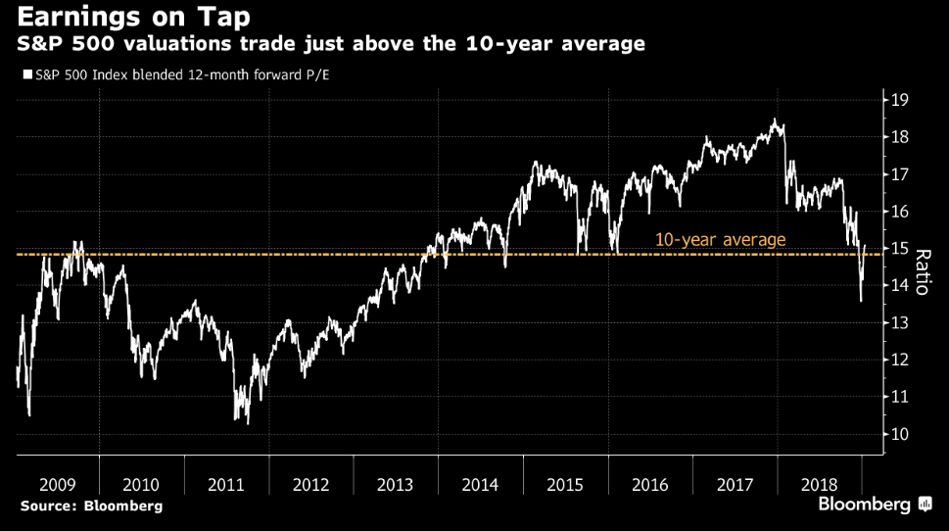

Slide 21
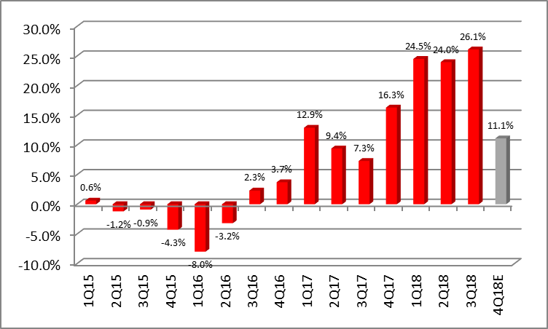
S&P 500 Earnings Growth

Slide 22
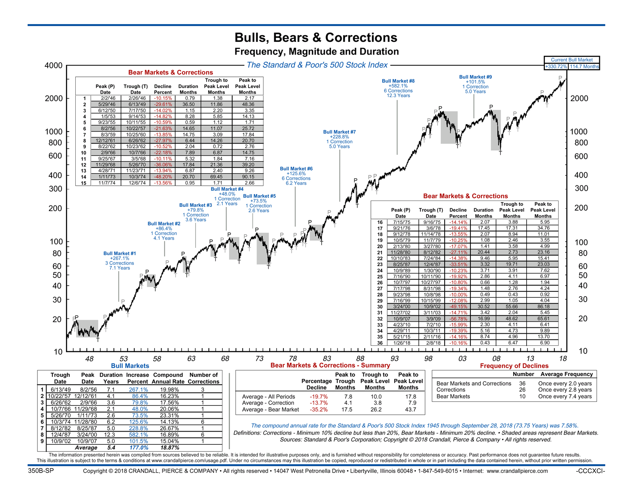
Bulls, Bears & Corrections: Frequency, Magnitude and Duration

Slide 23
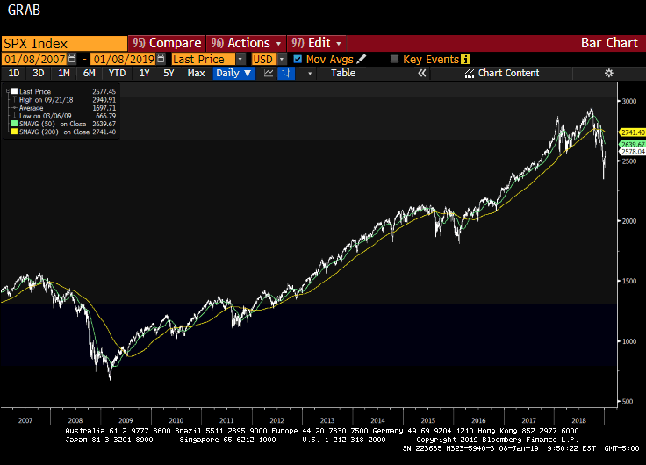
S&P 500 Index Peak-to-Trough-to-Peak 5.5 Years

Slide 24
Potential Economic Headwinds for 2019
Yield Curve Flattening/Inversion?
“Do not Fight the Fed!”
Potential Trade-Conflicts/Trade Wars
Corporate Bond Credit Risk/Spreads Widening
House Democrats Stamp Out Trump’s Pro-Growth Policies
Federal Deficit Crowds Out Growth

Slide 25
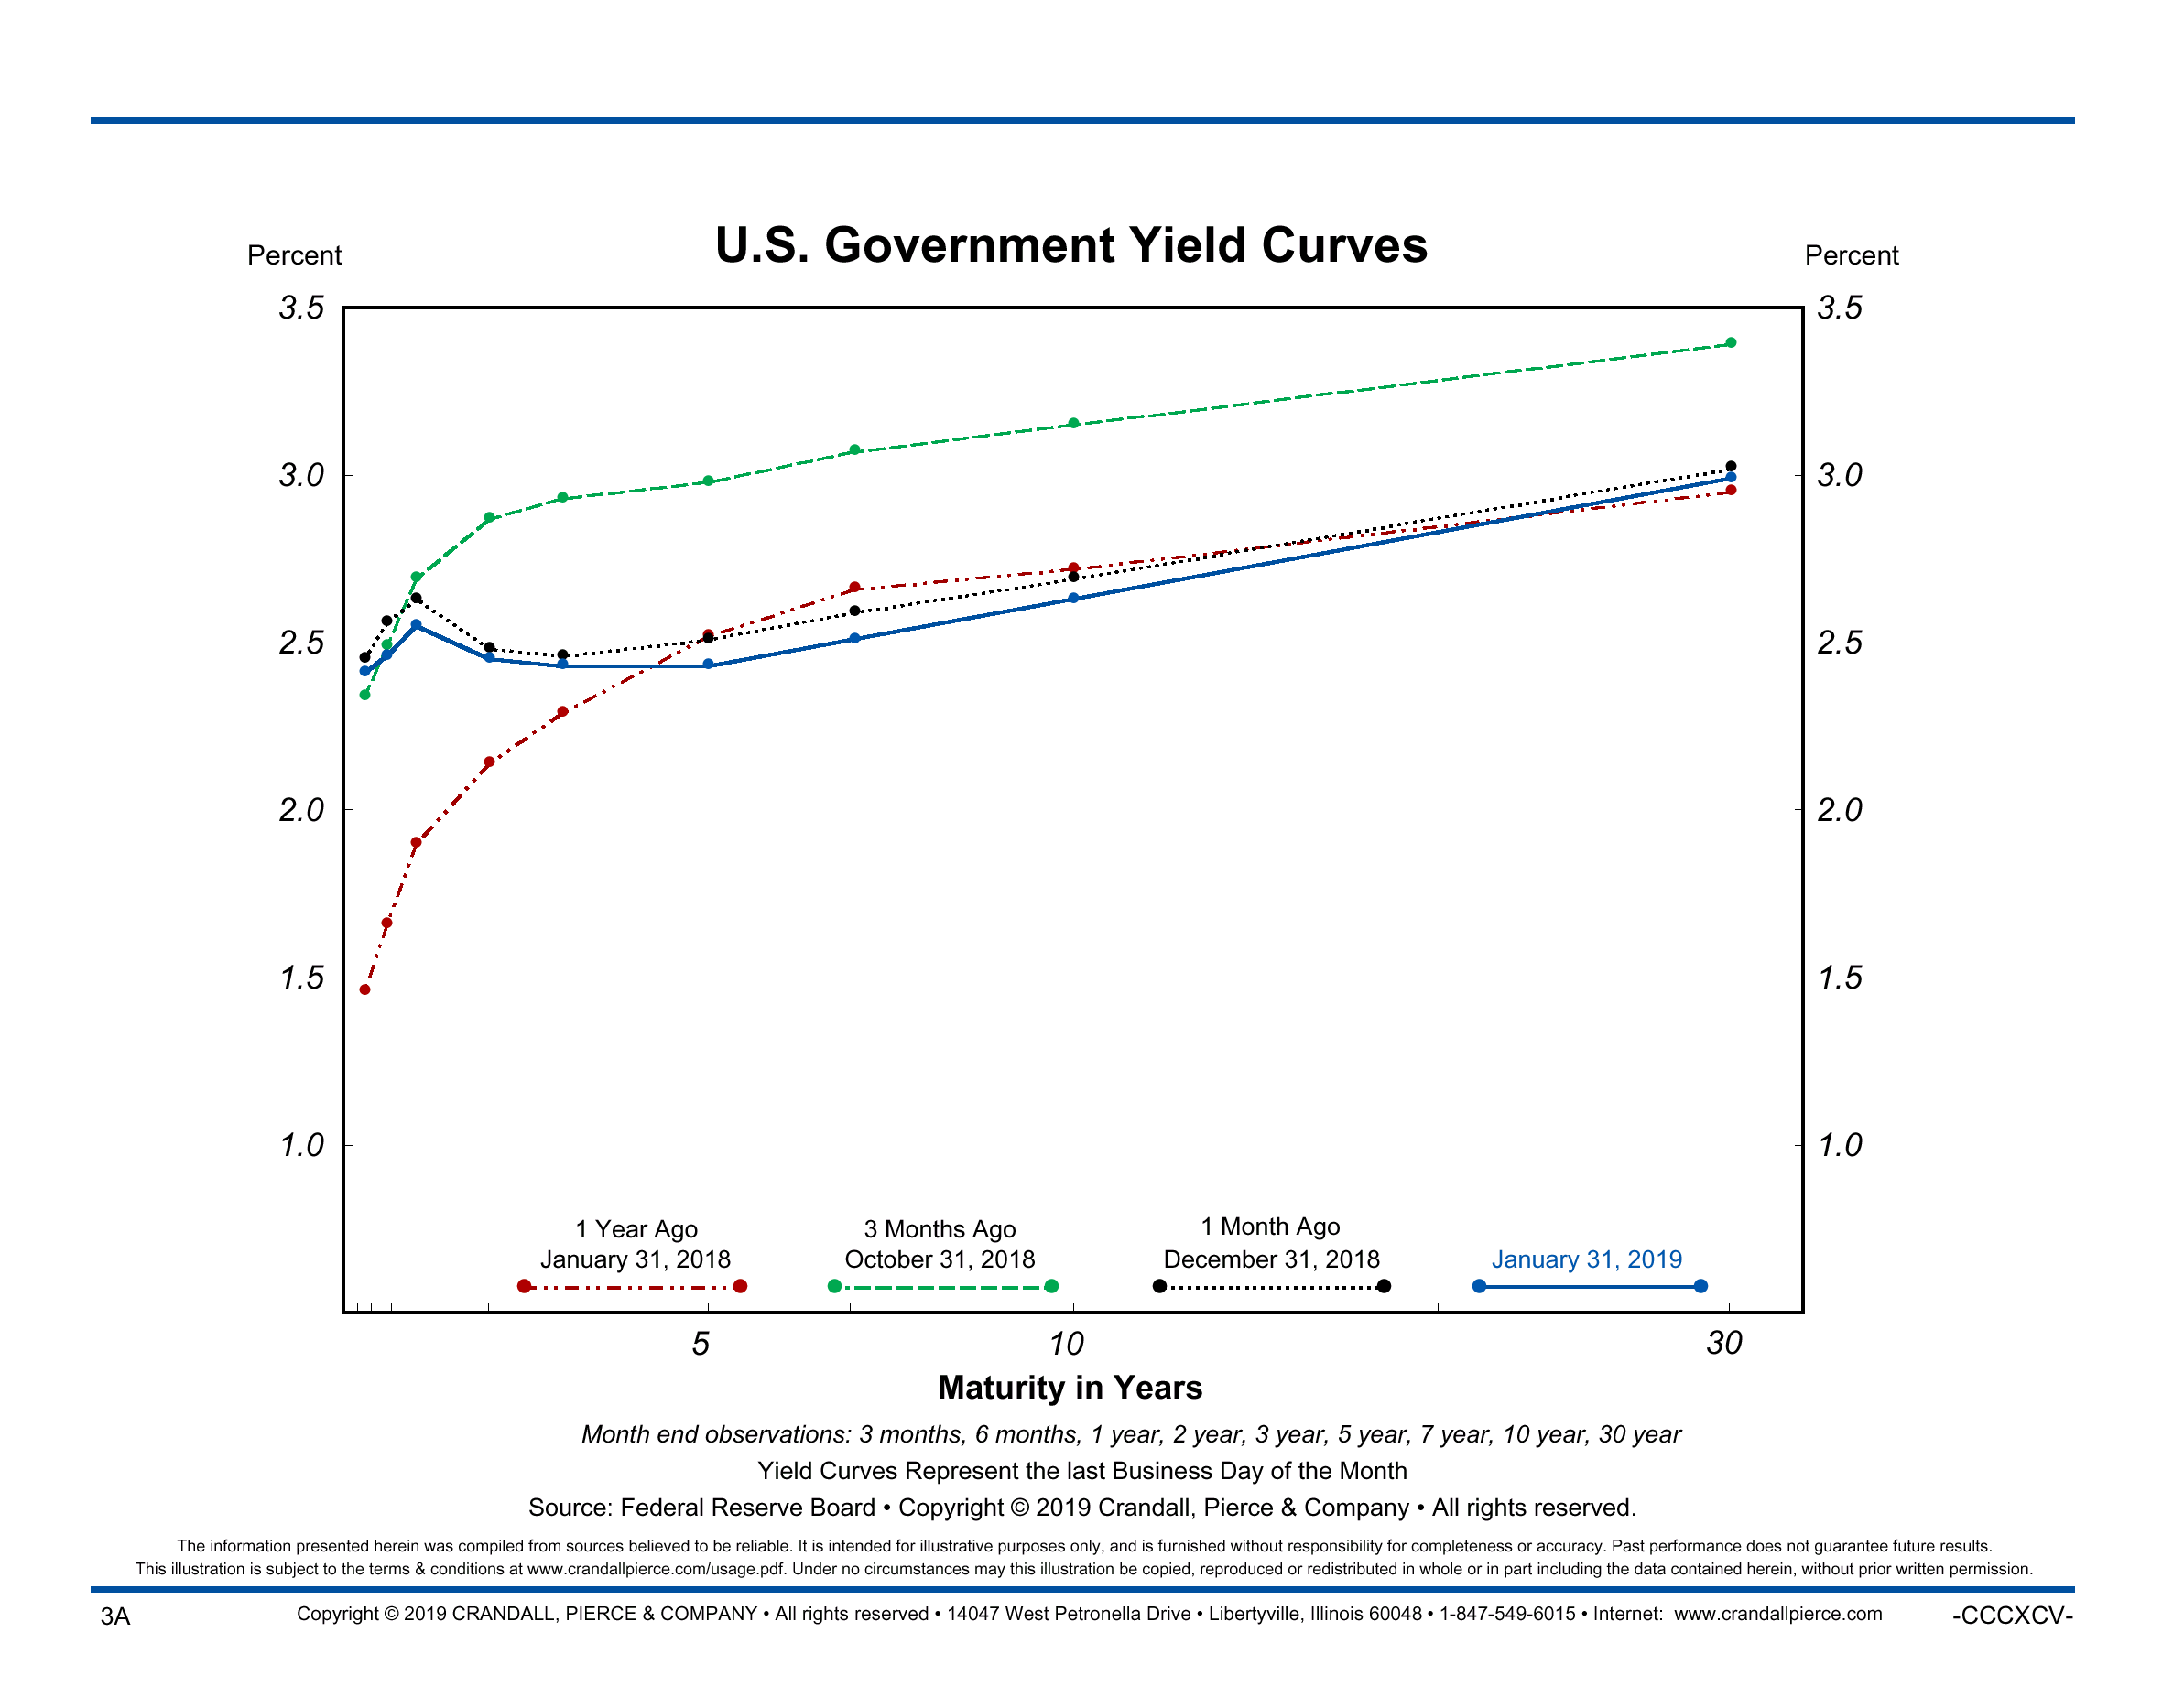
Yield Curve Flattening / Inversion

Slide 26
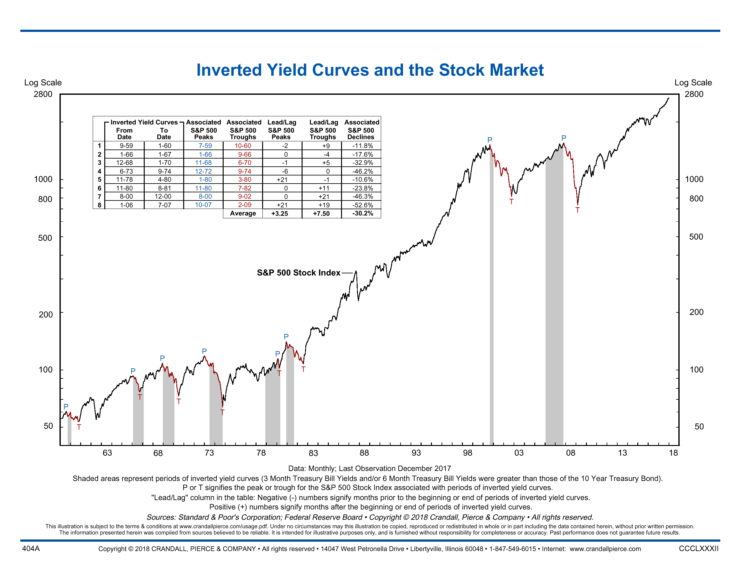

Slide 27
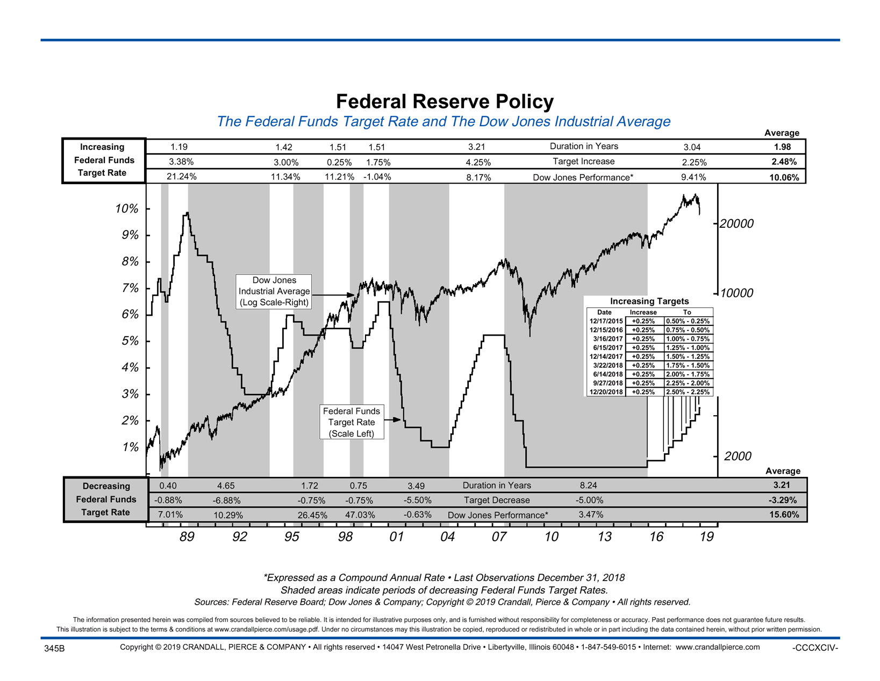
“Do Not Fight the Fed!”

Slide 28
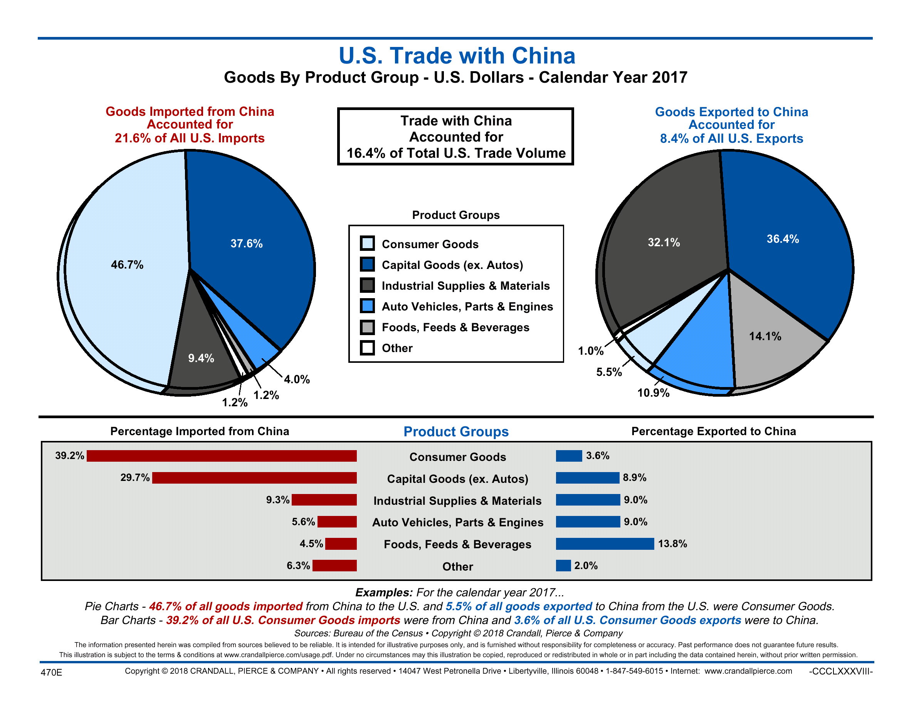
Potential Trade-Conflicts/Trade Wars

Slide 29
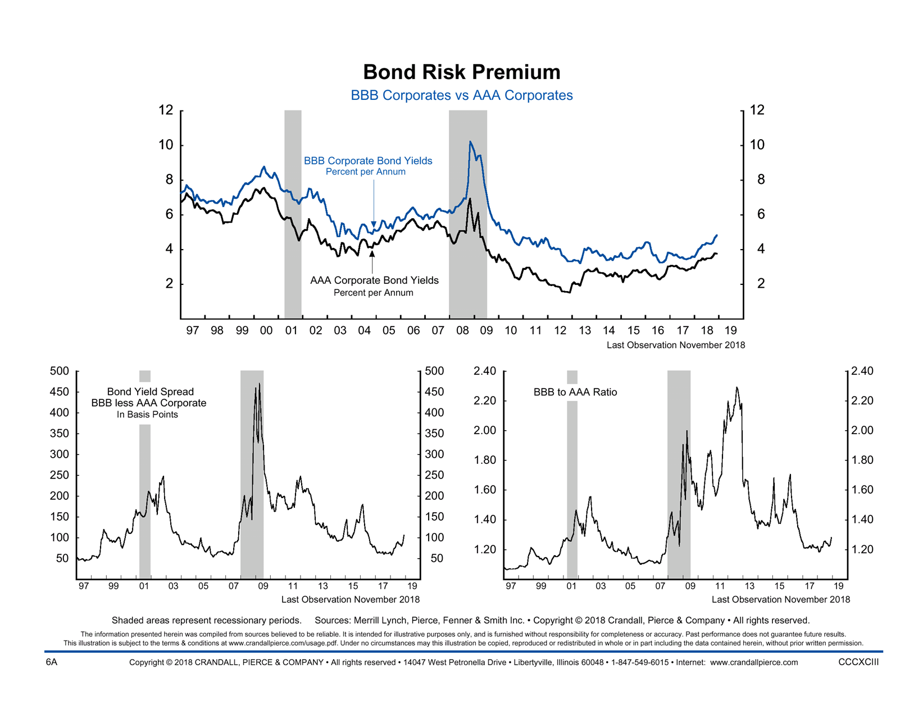
Corporate Bond Credit Risk/Spreads Widening

Slide 30
House Democrats Stamp Out Trump’s Pro-Growth Policies
Lower Corporate/Individual Tax Rate Cut Safe for Now
Republicans: Make the Personal Tax Cuts Permanent
Cut Middle Class tax rates another 10%
Introduce more stringent work requirements for SNAP benefit recipients
Democrats: Raise Corporate tax rates from 21% to 25%
Increase Personal tax rates for highest bracket from 37% to 39.6%
Increase estate tax rates while lowering the exemption
$1.0 Trill Infrastructure Package Possible but Unlikely
Republicans: $1.5 Trillion infrastructure program spread over a decade
Funded by an estimated $300-$400 billion in repatriation taxes
Democrats: $1.0 Trillion in Infrastructure Spending
Increased Emphasis on “Green” Initiates attached to bill
Paid for by higher personal & corporate taxes, carbon tax and a bond offering
Trade
Republicans: Reduce $600 Bill Balance-of-Trade deficit through stronger export volume
Democrats: Immediate Minimum-wage increase to $15 per hour
Increased oversight and approval on any new trade agreements
Health Care Reform
Republicans: Lower drug prices using Medicare’s enormous purchasing power to negotiate volume discounts
Dismantle ACA
Democrats: Drug-price controls on the pharmaceutical companies leading to less R&D and new discoveries
Single-payer “Medicare-for-All” Health Care system

Slide 31
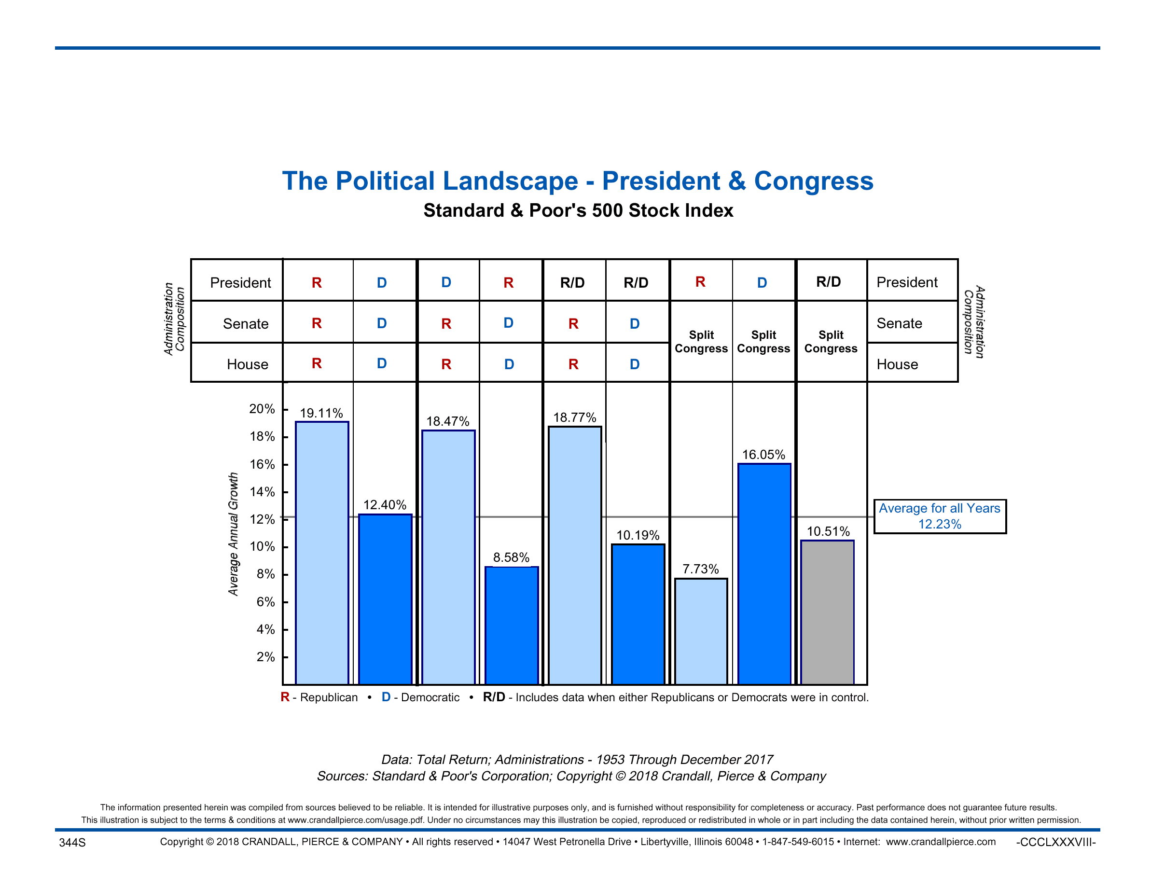

Slide 32
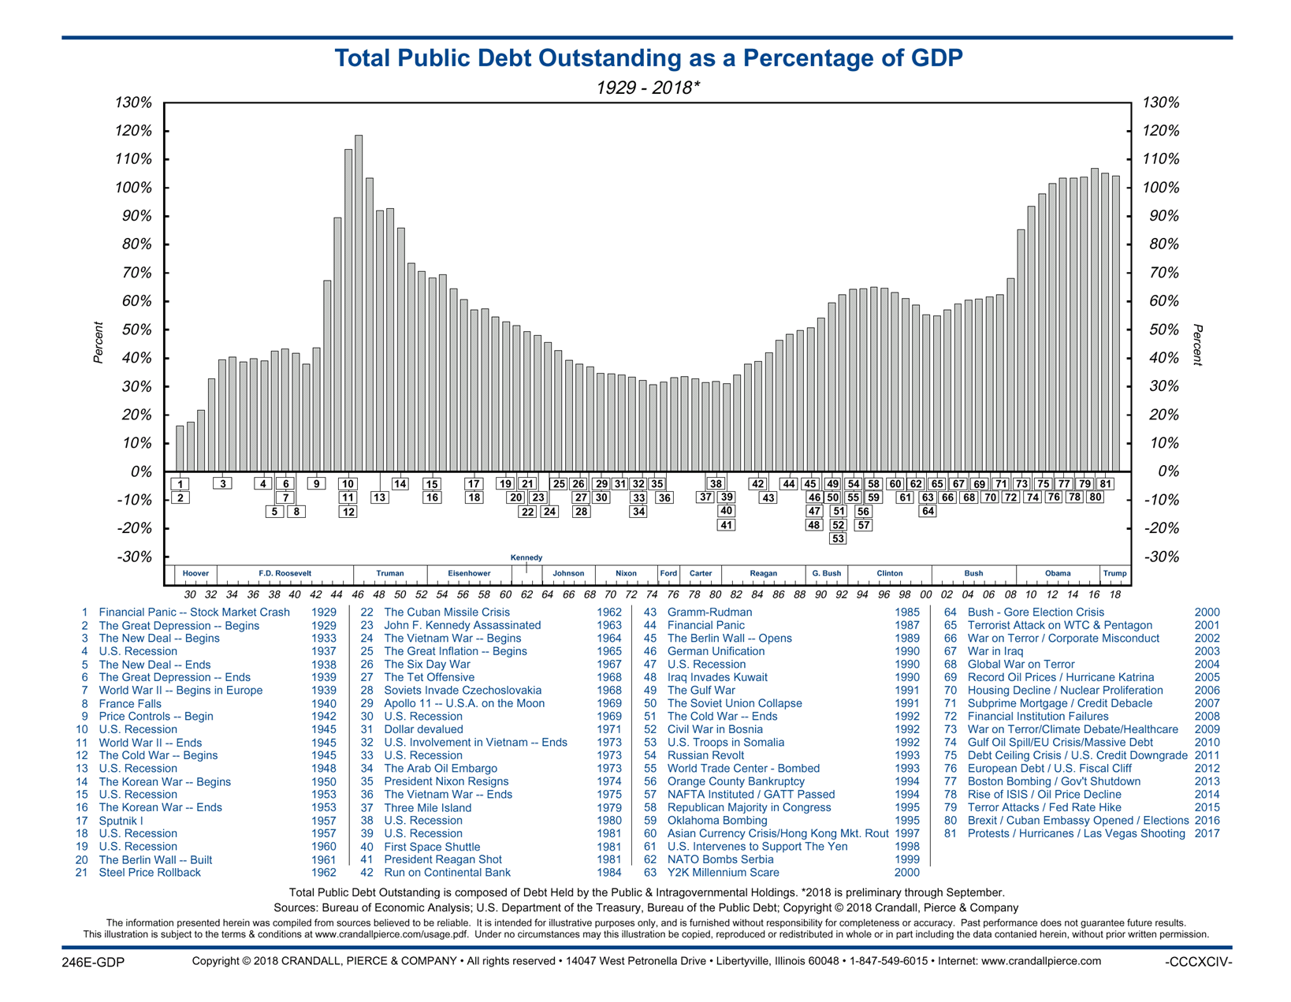
Federal Deficit Crowds Out Growth

Slide 33
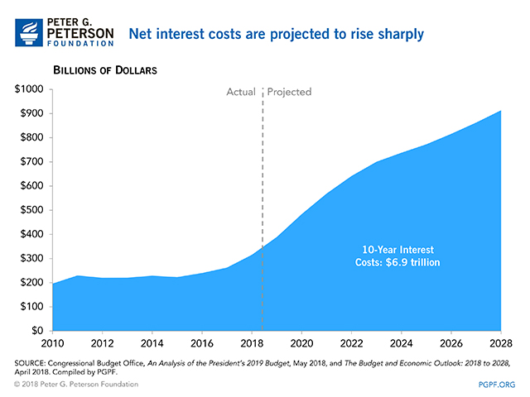
Current Interest Cost of $383 Bill is Projected to Double by 2026

Slide 34
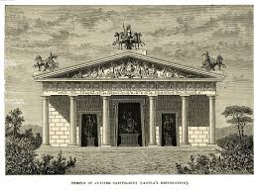
Pillars Supporting the Stock Market
Temple of Jupiter Optimus Maximus
Federal Debt
Negative
Interest Rates
Neutral
GDP
Positive Inflation
Positive
S&P Profit Growth Positive Yield Curve
Negative

Slide 35
Is 2018 as “Good as it Gets”?
Country
GDP Growth
United States
2.50%
Europe
1.30%
UK
1.50%
Germany
1.60%
Japan
0.90%
China
6.20%
1. Higher Probability of a Soft Landing over a Deep Recession
  Consumption (+2.7%) supported by low UE, steady incomes, falling gas prices and fading tax cuts.
  Probability of a Recession in the U.S. (two consecutive quarters of negative GDP Growth) is 20%.
  Business/Fixed Investment Growth will gradually Slow from 3.5% to 3.0%.
2. Federal Reserve Tightening in the System has not been Fully Digested
  The Fed has scaled back their Projected Interest-Rate Increases from Two to ZERO!
  FFUND’s Rate Estimated to be 2.25-2.50%, has resulted in continued “Flattening” of the Yield Curve.
  On Average the Fed begins CUTTING Rates just Five Months after they STOPPED Tightening!
3. Inflation is Rising, but at a Slow & Manageable Rate
  Wage Growth is rising (+3.2%) on lower UE (3.6%), but is not causing Margin Pressure.
  Oil should Drop to Below $60 per barrel as Commodity Prices Fall!
  PCE Index touches ceiling at 2.0%.
4. Markets likely to Trade Flat-to-Slightly-Higher in a Narrow Range as Headwinds Mount!
  FY19 S&P 500 Index Profits Should Stay Positive for one more year Increasing by 7.0% YoY.
  Expecting the S&P 500 to Generate $170 in Profit Equating to a Projected S&P Target of $3,100.

Slide 36

Why Synovus Trust Company, N.A.
Our experienced trust and estate specialists, money managers, certified financial planners and other financial professionals share one goal: tailoring a comprehensive solution that is truly right for you.
We listen closely to your concerns and design solutions tailored to your individual circumstances.
We provide one source for estate planning advice, ongoing administrative services and attentive management of your assets.
Fee-based advice: manage your portfolio based on your objectives and market conditions, not commissions.
Extensive Experience working with Institutional Clients, including: Charitable Foundations, Corporate/ERISA, Educational Institutions, Insurance Companies, Hospitals, Public/Government and Union/Taft-Hartley Organizations.

Slide 37
Disclosure
Information contained herein was obtained from sources believed to be reliable; however we cannot guarantee its accuracy or completeness. The information, analysis and opinions expressed herein are for general and educational purposes only, and do not constitute investment, legal or professional advice. Statements of future expectations, estimates, projections, and other forward-looking statements are based upon available information. Actual results, performance, or events may differ materially from those expressed or implied in such statements.
In addition to the normal risks associated with investing, narrowly focused investments, investments in smaller companies and international investments may involve risk of capital loss from unfavorable fluctuation in currency values, from differences in generally accepted accounting principles or from economic or political instability in other nations. Emerging markets involve heighten risks related to the same factors, in addition to those associated with their relatively small size and lesser liquidity.
Indices are not managed and are provided for illustrative purposes only. Clients cannot invest directly in indices. Index performance returns do not reflect any management fees, transaction costs, or expenses. Past performance does not guarantee future results.
Trust services for Synovus are provided through Synovus Trust Company, N.A. Investment products and services are not FDIC insured, are not deposits of or other obligations of Synovus Bank, are not guaranteed by Synovus Bank, and involve investment risk, including possible loss of principal invested. Past performance is not a guarantee of future results. This is not a solicitation to buy or sell any securities or mutual fund nor should it be construed as investment advice.
Standard & Poor’s Index (S&P 500)-A market capitalization weighted equity index maintained by Standard and Poors that seeks to be a benchmark of the large Cap U.S. stock market. The index covers 400 industrial, 40 utility, 20 transportation, and 40 financial companies of the US markets (mostly NYSE issues). These 500 companies are spread across 10 economic sectors: Technology, Financials, Health Care, Energy, Consumer Discretionary, Consumer Staples, Industrials, Materials, Utilities, and Telecommunications.
Russell 3000 Index-A market capitalization weighted equity index maintained by the Russell Investment Group that seeks to be a benchmark of the entire U.S. stock market. More specifically, this index encompasses the 3,000 largest U.S.-traded stocks, in which the underlying companies are all incorporated in the U.S. The index is further divided by market capitalization and investment style. Russell 1000 Value, Russell 1000 Growth, Russell Mid Cap Value, Russell Mid Cap Growth, Russell 2000 Value, and Russell 2000 Growth.
MSCI EAFE Index-An index created by Morgan Stanley Capital International (MSCI) that serves as a benchmark of the performance in major international equity markets as represented by 21 major MSCI indexes from Europe, Australia and Southeast Asia. The index is further divided into 4 major regions: the U.K., Europe ex-U.K., Japan, Pacific ex-Japan.
MSCI Emerging Markets Index-An index created by Morgan Stanley Capital International (MSCI) that is designed to measure equity market performance in global emerging markets. The Emerging Markets Index is a float-adjusted market capitalization index that consists of indices in 21 emerging economies: Brazil, Chile, China, Colombia, Czech Republic, Egypt, Hungary, India, Indonesia, Korea, Malaysia, Mexico, Morocco, Peru, Philippines, Poland, Russia, South Africa, Taiwan, Thailand, and Turkey.
Barclays Capital Aggregate Bond Index-An index maintained by Barclay’s Capital that includes all publicly issued, non-convertible domestic debt of the US Government and all its agencies, all investment-grade corporate debt and all mortgage-backed securities. The minimum maturity is one year, but there is no maximum maturity. The bonds must have at least $250 million par amount outstanding.

